Slide 1
Avances y retrocesos Artículo 2

Slide 2
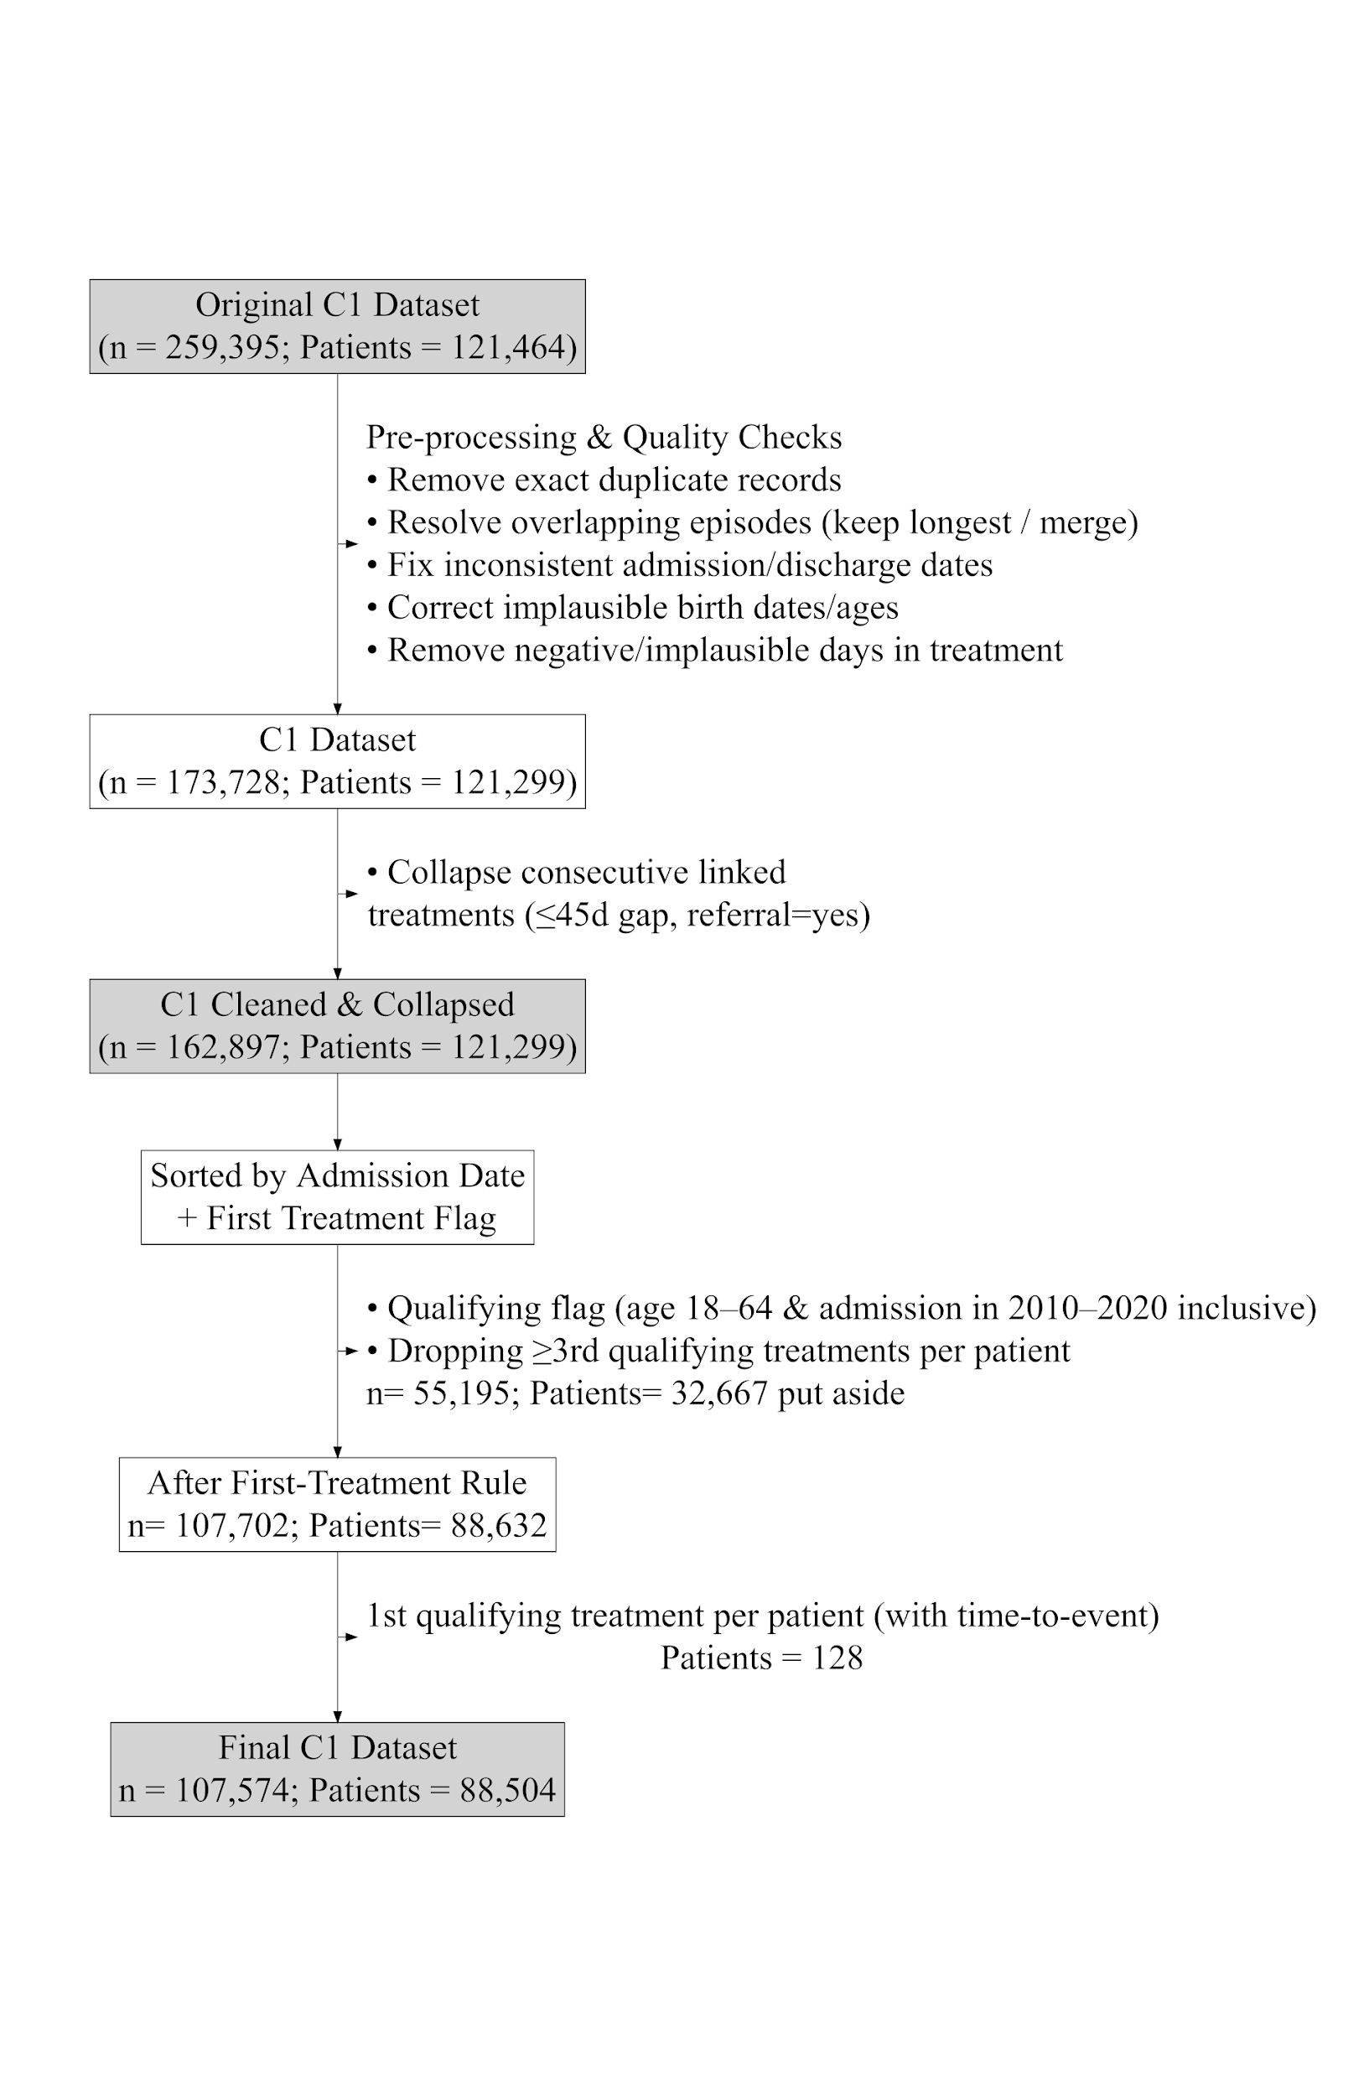
Recordatorio (objetivos)
To identify potential prognostic factors of the risk and time-to-event of the first readmission to SUD treatment (i) and mortality (ii) of patients of working age (18-64) in Chilean SUD adult treatments between 2010-2020 at baseline, and quantifying the strength of association of these factors.
To identify the key set of predictors and interactions between them, including length of stay and alternative measures (different cut-offs or measurement scales) and treatment outcome, needed to predict the risk and time to event to the first readmission to SUD treatment (i) and mortality (ii) among patients aged 18-64 in Chilean SUD adult treatments from 2010-2020.
To estimate the probability of a patient being readmitted and alive, without readmission, and alive and dead, at 1, 3, and 5 years since admission, under different hypothetical baseline treatment lengths and outcomes and other covariate characteristics as well, of patients of working age (18-64) in Chilean SUD adult treatments between 2010-2020 at baseline.

Slide 3
Variable | Label
adm_age_rec3 | Admission age
porc_pobr | Poverty index of commune of residence
dit_m | Length of stay in treatment (months)
tenure_status_household | Housing situation
prim_sub_freq_rec | Primary-substance use frequency at admission (simplified)
national_foreign | Changed chilean as the reference value
urbanicity_cat | Urbanization level of commune of residence
ed_attainment_corr | Educational attainment
evaluacindelprocesoteraputico | Assessment of the therapeutic process
eva_consumo | Evaluation of consumption pattern at discharge
eva_fam | Family situation evaluation at discharge
eva_relinterp | Interpersonal relations evaluation at discharge
eva_ocupacion | Occupational situation evaluation at discharge
eva_sm | Mental health evaluation at discharge
eva_fisica | Physical health evaluation at discharge
eva_transgnorma | Social norm transgression evaluation at discharge
ethnicity | Ethnicity (=1)
dg_psiq_cie_10_instudy | Psychiatric comorbidity (ICD-10, in-study)
dg_psiq_cie_10_dg | Psychiatric comorbidity (ICD-10, diagnosis record)
dx_f3_mood | Mood disorders (F3)
dx_f6_personality | Personality disorders (F6)
dx_f_any_severe_mental | —
any_phys_dx | —
polysubstance_strict | Polysubstance use (strict)
sex_rec_woman | Changed to reflect man as the reference value
cohabitation_family_of_origin | Cohabitation status (harmonized)
cohabitation_with_couple_children | Cohabitation status (harmonized)
Variables seleccionadas para el análisis de desempeño:
En rojo, añadidas
En verde, predictores que se asume más importantes
Azul, supuestos estratificadores

Slide 4
Variable | Label
cohabitation_others | Cohabitation status (harmonized)
sub_dep_icd10_status_drug_dependence | SUD severity (ICD-10)
any_violence_1_domestic_violence_sex_abuse | Domestic violence/Sexual abuse (mapped to any_violence)
tr_outcome_referral | Treatment outcome (subcategory: referral)
tr_outcome_dropout | Treatment outcome (subcategory: dropout)
tr_outcome_adm_discharge_rule_violation_undet | Treatment outcome (subcategory: adm discharge rule violation)
tr_outcome_adm_discharge_adm_reasons | Treatment outcome (subcategory: adm discharge reasons)
tr_outcome_other | Treatment outcome (subcategory: other)
adm_motive_sanitary_sector | Admission motive (subcategory: sanitary sector)
adm_motive_another_sud_facility_fonodrogas_senda_previene | Admission motive (other subcategory)
adm_motive_justice_sector | Admission motive (subcategory: justice sector)
adm_motive_other | Admission motive (subcategory: other)
first_sub_used_alcohol | First substance used (marijuana: ref)
first_sub_used_cocaine_paste | First substance used (marijuana: ref)
first_sub_used_cocaine_powder | First substance used (marijuana: ref)
first_sub_used_other | First substance used (marijuana: ref)
primary_sub_mod_cocaine_powder | Primary substance of use (recoded to group hallucinogens, opioids, inhalants, tranquilizers, stimulants)
primary_sub_mod_alcohol | Primary substance of use (recoded to group hallucinogens, opioids, inhalants, tranquilizers, stimulants)
primary_sub_mod_marijuana | Primary substance of use (recoded to group hallucinogens, opioids, inhalants, tranquilizers, stimulants)
primary_sub_mod_others | Primary substance of use (recoded to group hallucinogens, opioids, inhalants, tranquilizers, stimulants)
tipo_de_vivienda_rec2_other_unknown | Housing type (recoded & simplified)
plan_type_corr_pg_pr | Treatment modality (plan type, reference: basic ambulatory)
plan_type_corr_m_pr | Treatment modality (plan type, reference: basic ambulatory)
plan_type_corr_pg_pai | Treatment modality (plan type, reference: basic ambulatory)
plan_type_corr_m_pai | Treatment modality (plan type, reference: basic ambulatory)
occupation_condition_corr24_unemployed | Employment status (subcategory: unemployed)
occupation_condition_corr24_inactive | Employment status (subcategory: inactive)
marital_status_rec_single | Marital status (subcategory: single)
marital_status_rec_separated_divorced_annulled_widowed | Marital status (subcategory: separated/divorced/annulled/widowed)

Slide 5
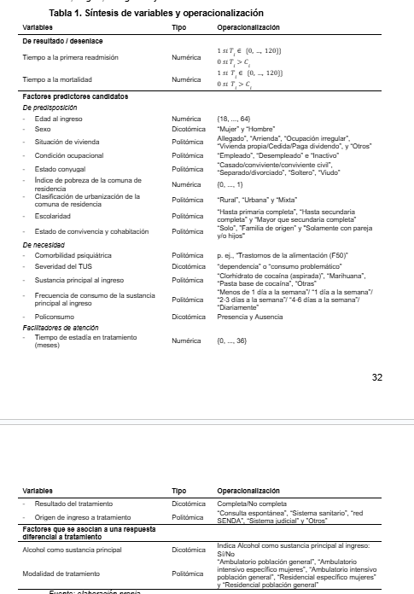
Recordatorio
Previo)
Aplicar one-hot encoding en features categóricas y transformar predictores numéricos
Near-zero variance / sparse data bias (Kuhn & Johnson 2013)
PENDIENTE= Truncado adm. (0.2%) + tto. en curso(0.1%)
1) Modelos predictivos para cada desenlace
No-proporcionalidad?, no necesario en modelos predictivos (bootstrap como opción: Stensrud & Hernán, 2020; Rashetnia, 2021, Jan 20)
Opatha, N. W., Jayasinghe, C. L., & Silva, R. M. (2025). Impact of censoring proportion on the performance of machine learning and Bayesian survival analysis approaches: Simulated and real data study linked with maternal and child health. Communications in Statistics: Case Studies, Data Analysis and Applications, 1–17. https://doi.org/10.1080/23737484.2025.2573913
Traditional survival models; Cox Proportional Hazard and Accelerated Failure Time models, performed well for larger sample sizes and low censoring rates, particularly under increasing hazard scenarios. NO ES NECESARIO
MI PMM, M=5 , menor sesgo modelos multiestado , MAR (Curnow, et al., 2024)
15 donantes, 200 árboles, 5 bases, 10 iteraciones
(Stekhoven, & Buehlmann, 2012)
Cox (Billichová et al., 2024)
Interpretación fácil- transparente y simple
Menor precisión
Inclusión de efectos no lineales debe ser incorporada manualmente
Notes:
To take into account the lost of information due to censoring, we use estimators based on the inverse probability of censoring weight (IPCW) methods. The time-dependent AUC and the time-dependent BS can be extended to the interval ]0, τ ] by computing respectively the integrated AUC (iAUC) and the integrated BS (iBS)
iAUC (higher the better) and iBS (lower the better) on the validation sets.
We score predictive performance of the methods through internal validation (Royston and Altman, 2013) by randomly splitting M = 50 times each data set Dm (m = 1, · · · , M)
Criterio de performance
We applyone-hot encoding on categorical features and standardizenumerical features with the Z-score.
Stekhoven, D.J. and Buehlmann, P. (2012). 'MissForest - nonparametric missing value imputation for mixed-type data', Bioinformatics, 28(1) 2012, 112-118. https://doi.org/10.1093/bioinformatics/btr597.

Slide 6
Lo que estoy haciendo
Grillas de tiempo-al-evento, para evaluación
50 cuantiles entre el 5% y el 95% de los tiempos
Reformateamos readmisiones
Sesgo de tiempo inmortal (fallecidos que aparecen sin readmisión)
Para RSF/Coxnet, censurar en 0 es la aproximación más correcta
Para Fine-Gray, codificar como evento alternativo
Analizar desempeño
best_subset_based_on_calib_jan26.ipynb
best_subset_based_on_disc_jan26.ipynb
Permutación por variable (p=20):
Toma datos de prueba,
Cambia valores de cada variable, mezcla aleatoriamente
Calcula IBS
Repito permutación por m y k
Contribución marginal de cada covariable a la precisión predictiva (calibración global)
Score shifting: calcular sobre el cambio
Prueba de Cox PH sin regularización
Ver señal predictiva
Coeficientes
Comparación base con Coxnet
Descartamos variables
Varianza cercana a 0
Violencia doméstica + Abuso sex (los indicadores separados, el combinado lo dejamos).
Tipo de vivienda (de 5 categorías, simplificada a 2)
Usuario tribunal trat de drogas
Diagnósticos psiquiátricos por códigos (ej., f4_anxiety_stress_somatoform, f8_9_neurodevelopment_child)
De la fase de imputaciones, descartamos: Alta incertidumbre imputaciones:
Edad de inicio consumo
Diagnóstico físico (en estudio)
Núm. Reportado de ttos. Previos
Un modelo Cox no converge. De todas formas
Elastic Net λ ( α Σ |βⱼ| + (1 − α) Σ βⱼ² )
Incorporar intercepto (fx de supervivencia basal)
Α= .1 (Predominio Ridge
Punto de operación: λ = 0.1
Validación interna (Royston and Altman, 2013), división aleatoria k= 5 (readm) y k=10 (mort)
Para cada imputación m ∈ {1,…,M} y cada fold k ∈ {1,…,K}
A partir del índice 49 (idx), con un 1% de la máxima penalización (min_ratio= .001), lo más parecido a un Cox estándar, pero estabilizado por especificar 50 pasos (n_alphas=50)
Notes:
model also fits a baseline survival function. This step is necessary to transform relative risk estimates into subject‑specific survival probabilities (L1+L2): combina lasso y ridge, útil para variables corelacionadas, regulariza, fuerza (L1) lasso, a que B tengan coef 0
L2= Penalización por la suma de valores absolutos: Σ |βⱼ| Keep most variables in the equation, just shrink their effect sizes to prevent overfitting. we eliminated inmortal time bias (dead patients look like without readmission).
This correction is essentially the Cause-Specific Hazard preparation
Score shifting: En lugar de recalcular la predicción completa en cada iteración, actualicé el predictor lineal calculando únicamente la diferencia marginal de riesgo introducida por la variable permutada (mantener los coeficientes beta fijos), estás forzando al modelo a usar la información "basura" que le estás dando. Si el error incrementa sustancialmente, confirmas que el modelo realmente necesitaba esa variable.
la parte "predictiva" del modelo de Cox es una simple suma ponderada (producto punto).
No hago el predict completo, sino le resto el riesgo.

Slide 7
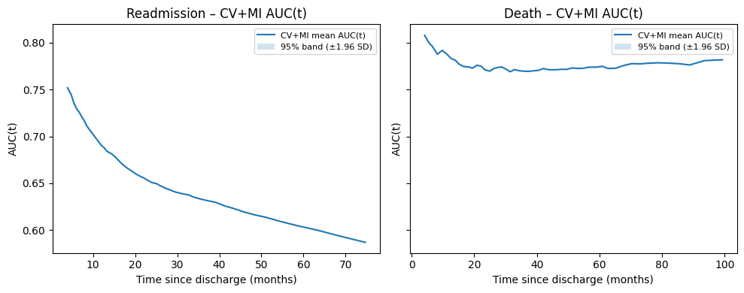
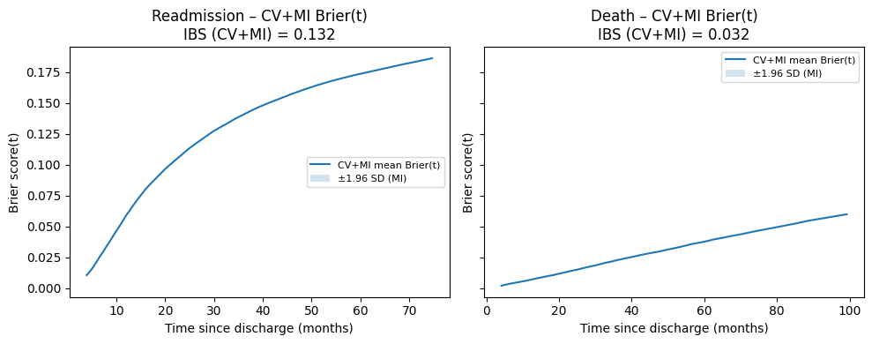
Hallazgos preliminares (exploratorio)
Desempeño (k x m)
Lasso (90%)
50 trayectorias de valores (n_alpha)
Alpha mediano (25)= ni tan simple, ni tan complejo
Readmission (CV, mean ± SD / IBS ): 0.608 ± 0.000 / 0.1317± 0.000
Death (CV, mean ± SD): 0.742 ± 0.001 / 0.0321 ± 0.000
Por centro
Uno C-index: 0.591 ± 0.080
IBS: 0.1476 ± 0.0522

Slide 8
Hallazgos preliminares, Elastic Net Ridge (90%) (permutación)
Característica | Incremento medio IBS | Desviación estándar IBS | Característica | Incremento medio IBS | Desviación estándar IBS
dit_m | 0.000539 | 0.000095 | adm_age_rec3 | 0,002701 | 0,000236
sex_rec_woman | 0.000510 | 0.000080 | primary_sub_mod_alcohol | 8,96E-05 | 1,75E-05
adm_age_rec3 | 0.000383 | 0.000133 | dit_m | 6,56E-05 | 3,97E-05
plan_type_corr_m_pr | 0.000227 | 0.000027 | eva_ocupacion | 4,41E-05 | 2,36E-05
plan_type_corr_pg_pr | 0.000155 | 0.000042 | eva_fisica | 4,03E-05 | 1,9E-05
ethnicity | 0.000139 | 0.000024 | prim_sub_freq_rec | 3,07E-05 | 1,25E-05
dg_psiq_cie_10_dg | 0.000118 | 0.000028 | tenure_status_household | 1,6E-05 | 1,59E-05
primary_sub_mod_alcohol | 0.000108 | 0.000040 | cohabitation_with_couple_children | 9,84E-06 | 4,04E-06
prim_sub_freq_rec | 0.000108 | 0.000032 | eva_sm | 5,74E-06 | 5,31E-06
sub_dep_icd10_status_drug_dependence | 0.000077 | 0.000027 | evaluacindelprocesoteraputico | 2,79E-06 | 2,91E-06
occupation_condition_corr24_unemployed | 0.000059 | 0.000022 | any_phys_dx | 2,47E-06 | 1,29E-06
primary_sub_mod_marijuana | 0.000056 | 0.000009 | eva_consumo | 2,27E-06 | 2,25E-06
eva_ocupacion | 0.000053 | 0.000037 | eva_fam | 1,13E-07 | 5,16E-07
ed_attainment_corr | 0.000045 | 0.000013 | urbanicity_cat | 0 | 0
eva_consumo | 0.000028 | 0.000029 | ed_attainment_corr | 0 | 0
plan_type_corr_pg_pai | 0.000021 | 0.000016 | porc_pobr | 0 | 0
tr_outcome_adm_discharge_rule_violation_undet | 0.000017 | 0.000011 | eva_transgnorma | 0 | 0
any_violence_1_domestic_violence_sex_abuse | 0.000017 | 0.000011 | ethnicity | 0 | 0
dx_f6_personality | 0.000009 | 0.000004 | dg_psiq_cie_10_dg | 0 | 0
tr_outcome_referral | 0.000002 | 0.000003 | dg_psiq_cie_10_instudy | 0 | 0
Readmisión (k x m x p = 1,250)
Mean ± SD: 0.1340 ± 0.0016
Range: [0.1322, 0.1360]
Null (KM) IBS: 0.1351
Mortalidad (k x m x p= 2,500)
Mean ± SD: 0.0319 ± 0.0010
Range: [0.0298, 0.0338]
Null IBS: 0.0335

Slide 9
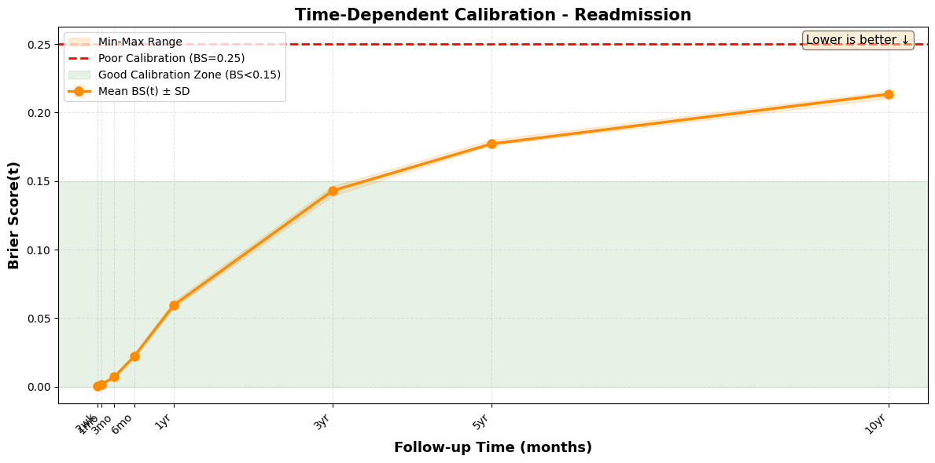
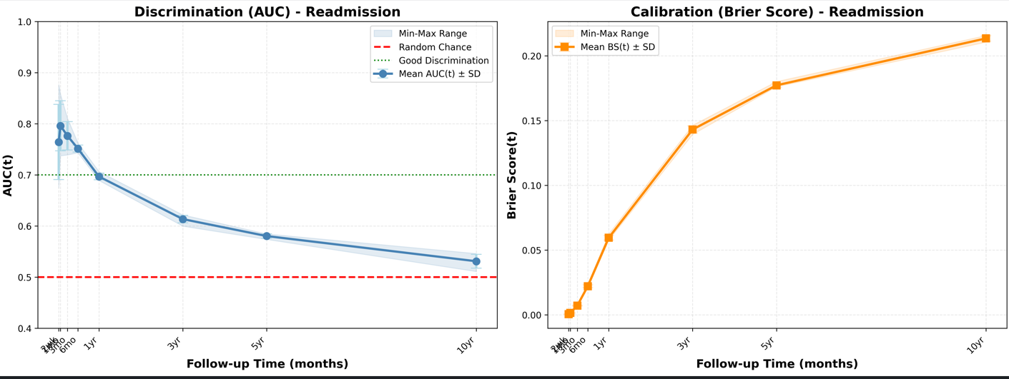
TIME-SPECIFIC EVALUATION (Elastic net)
IBS (Integrated Brier Score): 0.1530 ± 0.0011 IBS Range: [0.1521, 0.1551] / C-index: 0.5852 ± 0.0029 Mean AUC(t): 0.6888 ± 0.1001
CALIB= Woman, days in treatment, plan type (residential), ethnicity, ICD-10 psych diagnosis, admission age, primary substance frequency
DISC= Admission age, woman, plan type (residential), days in treatment, plan type (residential-WO), ethnicity, ICD-10 psych diagnosis, primary substance (alcohol), ICD-10 drug dependence, primary substance use frequency, primary substance use (marijuana), occupational condition (unemployed)
Etiqueta de tiempo | AUC promedio | AUC desv est | Media BS bootstrap | Desviación estándar bootstrap | Número de evaluaciones
2 semanas (2wk) | 0.764389 | 0.073513 | 0.000441 | 0.000156 | 25
1 mes (1mo) | 0.796113 | 0.049126 | 0.001378 | 0.000369 | 25
3 meses (3mo) | 0.776517 | 0.027678 | 0.007091 | 0.000321 | 25
6 meses (6mo) | 0.751451 | 0.006827 | 0.022060 | 0.001076 | 25
1 año (1yr) | 0.696899 | 0.006419 | 0.059455 | 0.001705 | 25
3 años (3yr) | 0.613649 | 0.007426 | 0.143035 | 0.002852 | 25
5 años (5yr) | 0.580468 | 0.177174 | 0.177174 | 0.001576 | 25
10 años (10yr) | 0.531187 | 0.013521 | 0.213420 | 0.002054 | 25

Slide 10
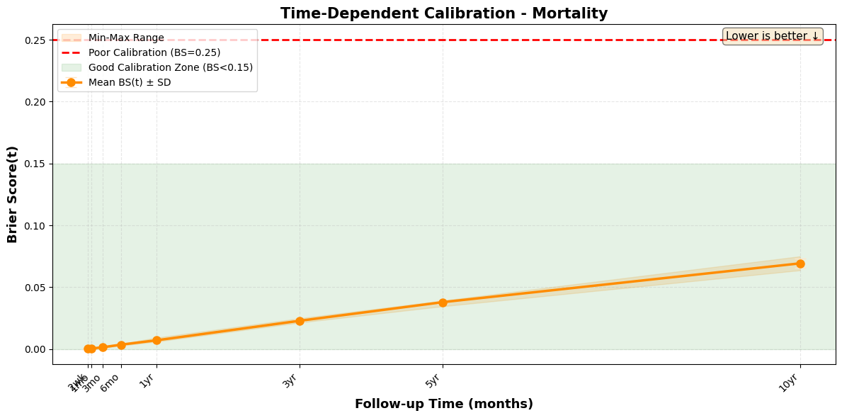
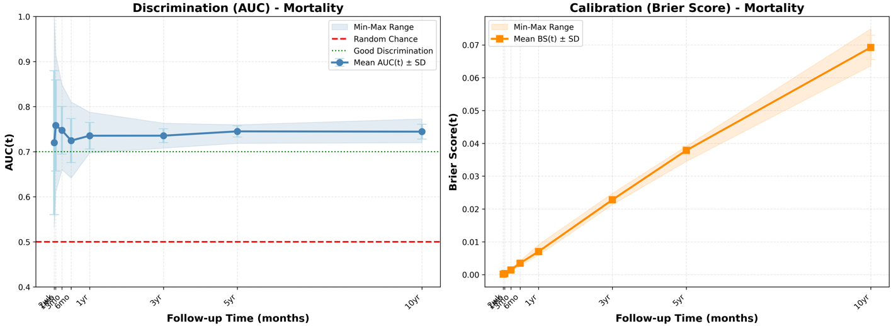
TIME-SPECIFIC EVALUATION (Elastic net)
IBS (Integrated Brier Score): 0.0363 ± 0.0013 IBS Range: [0.0338, 0.0386] / C-index: 0.7106 ± 0.0174 Mean AUC(t): 0.7399 ± 0.0653
CALIB= Admission age, primary substance at admission (alcohol), days in treatment, physical evaluation at discharge, occupational condition at discharge, primeray substance use frequency, tenure status of household
DISC= Admission age, primary substance at admission (alcohol), occupational condition at discharge, primary substance use frequency, physical evaluation at discharge, days in treatment, tenure status of household
Etiqueta de tiempo | AUC promedio | AUC desv est | Media BS bootstrap | Desviación estándar bootstrap | Número de evaluaciones
2 semanas (2wk) | 0.720098 | 0.159546 | 0.000124 | 0.000148 | 50
1 mes (1mo) | 0.758296 | 0.101050 | 0.000328 | 0.000129 | 50
3 meses (3mo) | 0.747555 | 0.052906 | 0.001428 | 0.000395 | 50
6 meses (6mo) | 0.724674 | 0.048674 | 0.003483 | 0.000526 | 50
1 año (1yr) | 0.735512 | 0.029726 | 0.007036 | 0.000897 | 50
3 años (3yr) | 0.735603 | 0.015290 | 0.022802 | 0.000909 | 50
5 años (5yr) | 0.745161 | 0.012540 | 0.037846 | 0.001255 | 50
10 años (10yr) | 0.744511 | 0.016312 | 0.069244 | 0.003704 | 50

Slide 11
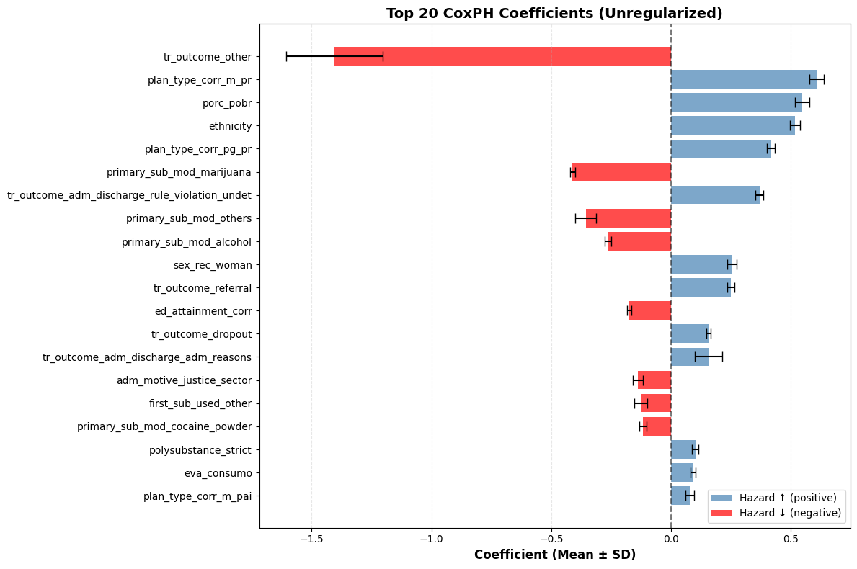
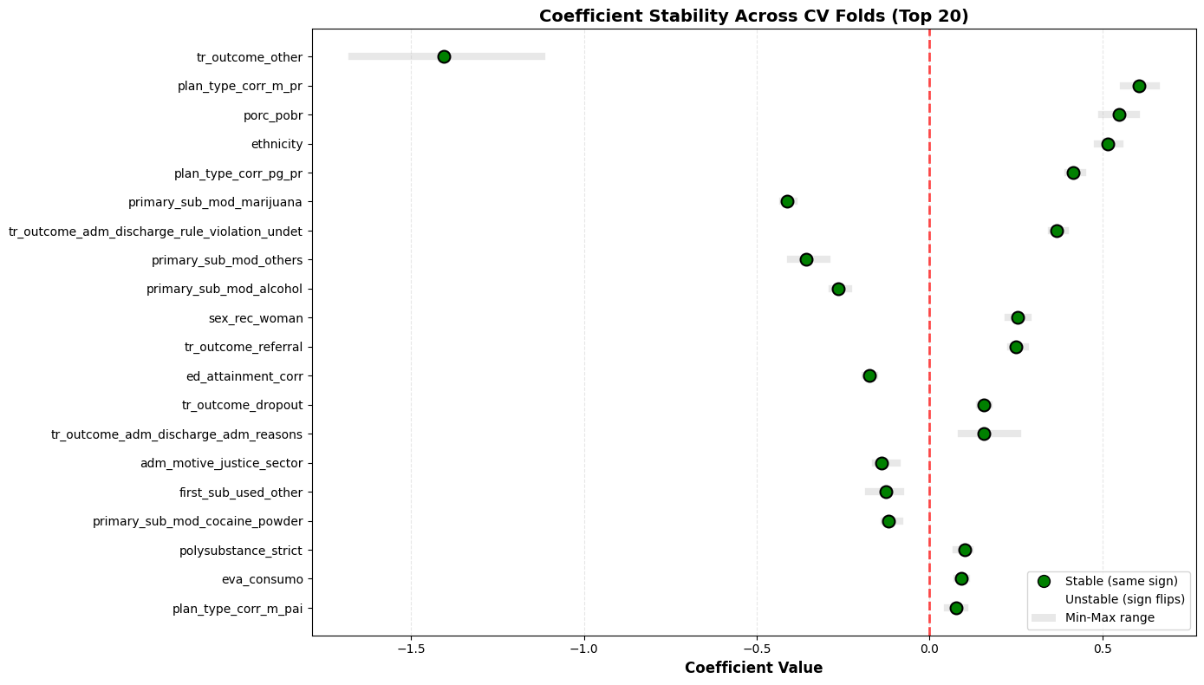
Cox PH sin regularización, MI & CV
READMISION
C-index: 0.6094 ± 0.0055
Mean AUC(t): 0.6710 ± 0.0751
IBS: 0.1528 ± 0.0014
Imputations: 5, CV folds: 5
Features: 56, Samples: 88504
Time points: 8
Time label | AUC mean | AUC sd | BS mean | BS sd | n_evals
2 semanas (2wk) | 0,7047 | 0,0757 | 0,0004 | 0,0002 | 25
1 mes (1mo) | 0,7568 | 0,0563 | 0,0014 | 0,0004 | 25
3 meses (3mo) | 0,7297 | 0,0327 | 0,0071 | 0,0003 | 25
6 meses (6mo) | 0,7112 | 0,0077 | 0,0219 | 0,0011 | 25
1 año (1yr) | 0,6819 | 0,0066 | 0,0589 | 0,0017 | 25
3 años (3yr) | 0,6320 | 0,0038 | 0,1413 | 0,0027 | 25
5 años (5yr) | 0,6041 | 0,0063 | 0,1759 | 0,0014 | 25
10 años (10yr) | 0,5478 | 0,0174 | 0,2159 | 0,0024 | 25

Slide 12
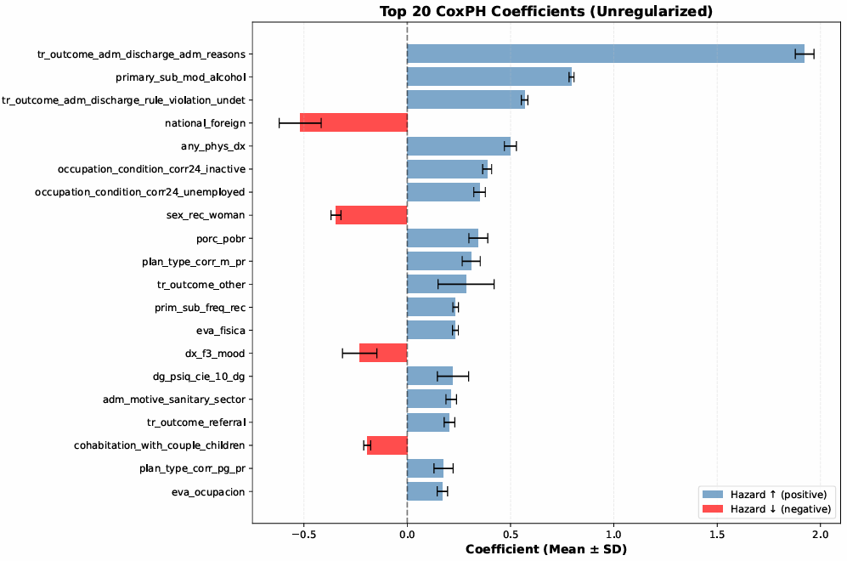
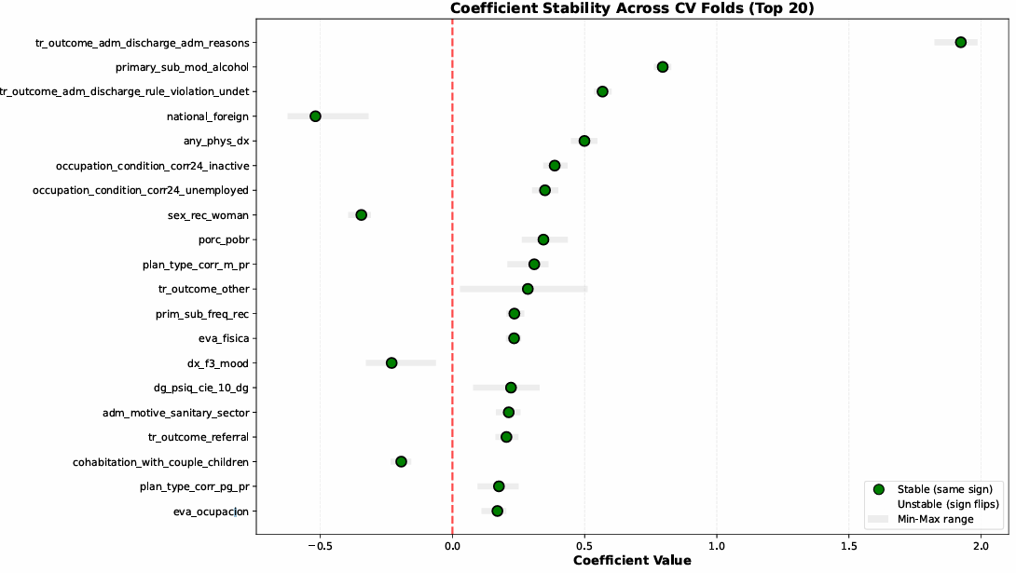
Cox PH sin regularización, MI & CV
MORTALIDAD
C-index: 0.6094 ± 0.0055
IBS: 0.1528 ± 0.0014
Imputations: 5, CV folds: 5
Features: 56, Samples: 88504
Time points: 8
time_label | AUC mean | AUC sd | BS mean | BS sd | n_evals
2 semanas (2wk) | 0,8760 | 0,0299 | 0,0001 | 0,0001 | 20
1 mes (1mo) | 0,8775 | 0,0583 | 0,0003 | 0,0001 | 25
3 meses (3mo) | 0,8638 | 0,0633 | 0,0014 | 0,0002 | 25
6 meses (6mo) | 0,8216 | 0,0261 | 0,0034 | 0,0003 | 25
1 año (1yr) | 0,8111 | 0,0293 | 0,0068 | 0,0006 | 25
3 años (3yr) | 0,7819 | 0,0064 | 0,0219 | 0,0003 | 25
5 años (5yr) | 0,7823 | 0,0078 | 0,0360 | 0,0005 | 25
10 años (10yr) | 0,7743 | 0,0099 | 0,0651 | 0,0012 | 25

Slide 13
Retroalimentación ACC 2026-01-23
Generar indicadores de especificidad y sensibilidad
PP y PPN, valores predictivos
Al año, readmission
Privilegiar variables modificables intervenibles
REFLEXION MIA:
violencia basada en género (VBG): abuso sexual, violencia doméstica y acoso sexual
condiciones de habitabilidad de menor a mayor grado de mejora
Abrir a estratos adicionales si hay modificación del efecto fuerte
Delta c-indez +0.01
LRT <0.01
Mejora IBS
Licit/ilicit-completa/nocompleta-modalidad= 20 modelos distintos
No es factible

Slide 14
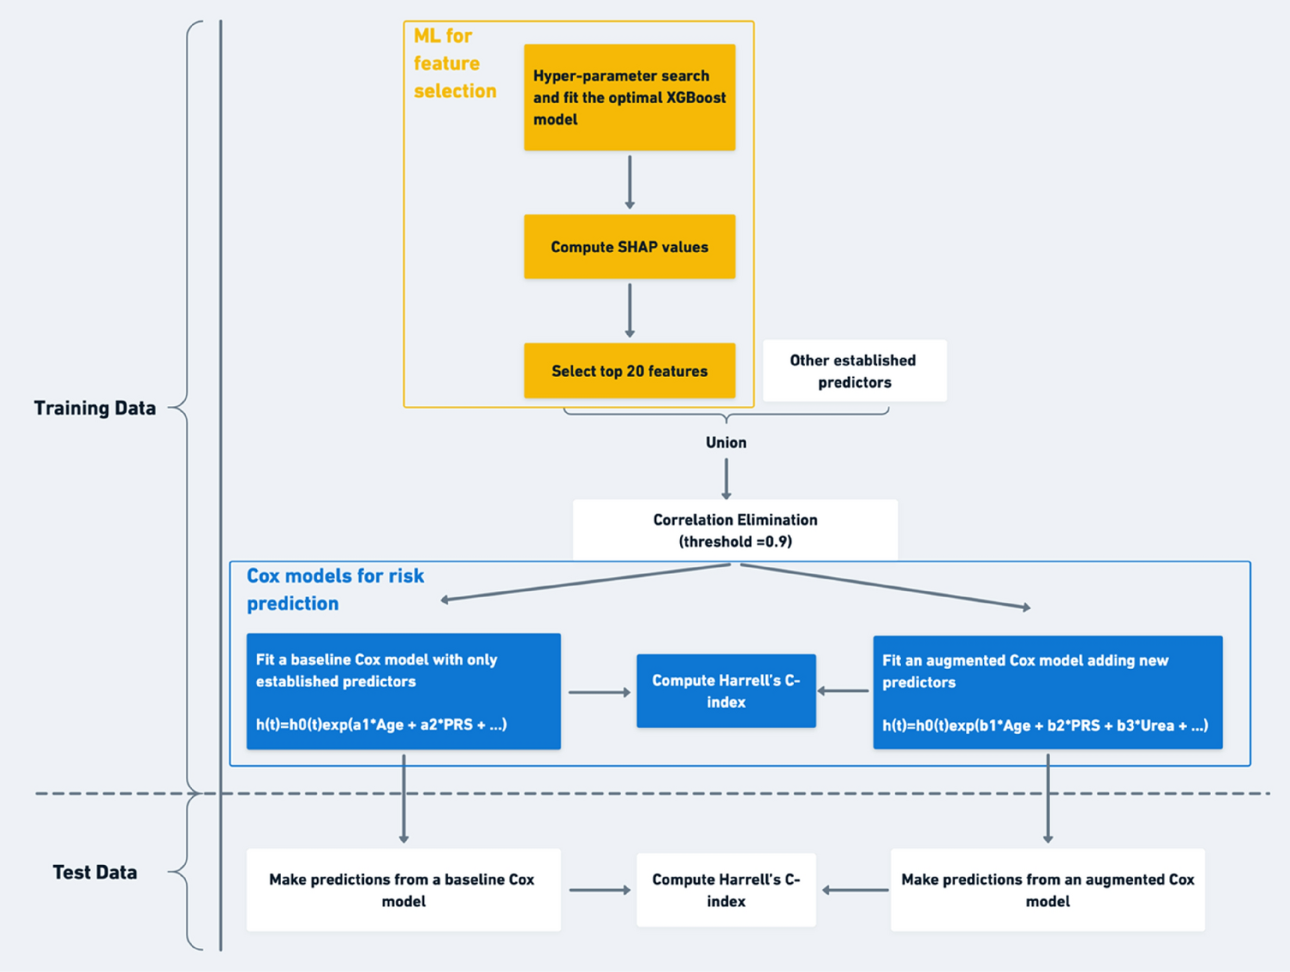
Liu, X., Morelli, D., Littlejohns, T.J. et al. Combining machine learning with Cox models to identify predictors for incident post-menopausal breast cancer in the UK Biobank. Sci Rep 13, 9221 (2023). https://doi.org/10.1038/s41598-023-36214-0
with pre-specified interest in the role of polygenic risk scores (PRS) for risk prediction= PERMITE A MI DEJAR COMO INTERES EL DIT Y EL RESULTADO DE TTO
“extreme gradient boosting” (XGBoost)
We then removed features with missing rate >30%, and those where all participants had the same value (such as rare diseases which no participants were affected by at baseline) which were of no discriminative utility
We performed multiple imputation using the mice package in R49 to impute the missing data under the assumption of missing at random (MAR).
Multicollinearity was assessed by computing the variance inflation factor (VIF); values less than 10 were considered acceptable
Shapley feature-importance measures were used for feature selection among 1.7 k features
compared the “augmented” Cox model (incorporating the two PRS, known and novel predictors) with a “baseline” Cox model
Risk discrimination was maintained in the augmented Cox model, yielding C-index 0.673 vs 0.667 (baseline Cox model)

Slide 15
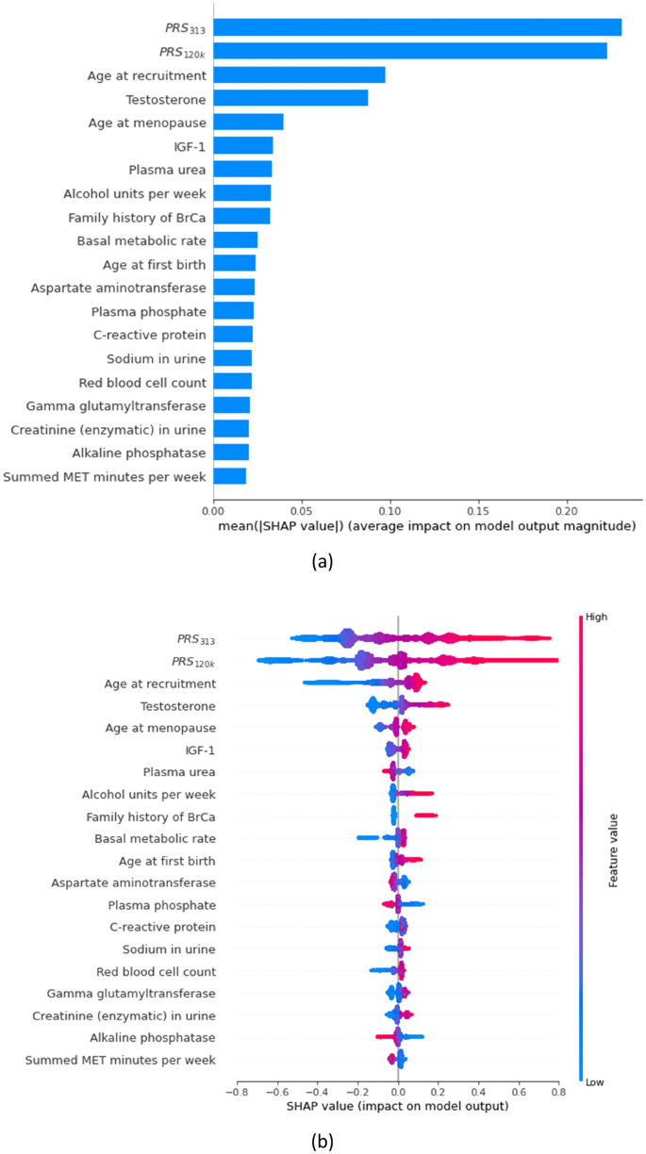
Liu, X., Morelli, D., Littlejohns, T.J. et al. Combining machine learning with Cox models to identify predictors for incident post-menopausal breast cancer in the UK Biobank. Sci Rep 13, 9221 (2023). https://doi.org/10.1038/s41598-023-36214-0
SHAP summary plots according to the XGBoost machine: (a) bar plot showing global SHAP values, and (b) beeswarm plot showing local SHAP values. The top 20 features for the risk of breast cancer were shown. Noticeably, both BrCa PRS are deemed of much higher importance than the remaining phenotypic features.
The x-axis corresponds to the SHAP value, with vertical dispersion/jitter indicating a high density of points. The colour gradient indicates the relative magnitude of each feature (not SHAP values) with red indicating high values of the feature (e.g. older age) and blue (e.g. younger age) the opposite.
The SHAP beeswarm plot shows the impact of the underlying values of each feature on model outputs, which is the change in the relative hazard (i.e. ) of developing breast cancer. It is informative in three ways: (1) the ranking indicates the relative importance of features; (2) the gradient of colour indicates the direction of effects; (3) the dispersion of points indicates whether the relationship of each feature with the outcome is linear (details below).
The colour gradient in the SHAP beeswarm plot indicates that there were five features (plasma urea, aspartate aminotransferase, plasma phosphate, alkaline phosphatase, and physical activity) that had higher values (i.e. red points) with negative SHAP values (i.e. decrease in relative hazard). This suggests potential protective effect of these features on developing breast cancer (i.e. higher values are associated with lower risk of breast cancer).
The symmetry in the range of the positive and negative SHAP values in the SHAP beeswarm plot suggests a linear relationship between the feature and the outcome. If the range of the positive SHAP values are longer than that of the negative SHAP values (or vice versa), this may suggest a non-linear relationship.

Slide 16
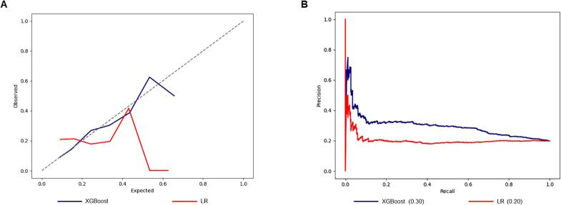
Balian, Jeffrey, et al. "Machine Learning Based Predictive Modeling of Readmissions following Extracorporeal Membrane Oxygenation Hospitalizations." Surgery Open Science, vol. 19, 2024, p. 125, https://doi.org/10.1016/j.sopen.2024.04.003. Accessed 2 Feb. 2026.
ten-fold cross-validation was utilized for the identification of appropriate hyperparameters
machine learning demonstrated superior discrimination, calibration and predictive power. Furthermore, we identified several patient factors predictive of readmission
Features of greatest predictive importance were described through SHAP Summary plots
Calibration (observed vs. expected plots)
The mean average precision (mAP) was calculated as the area under the precision-recall curve
Calibration plots were created to assess how well predicted probabilities matched expected outcomes
SHAP ( Guo J., Cheng H., Wang Z., Qiao M., Li J., Lyu J. (2023). Factor analysis based on SHapley Additive exPlanations for sepsis-associated encephalopathy in ICU mortality prediction using XGBoost - a retrospective study based on two large database. Front. Neurol. 14, 1290117. doi: 10.3389/fneur.2023.1290117 )

Slide 17
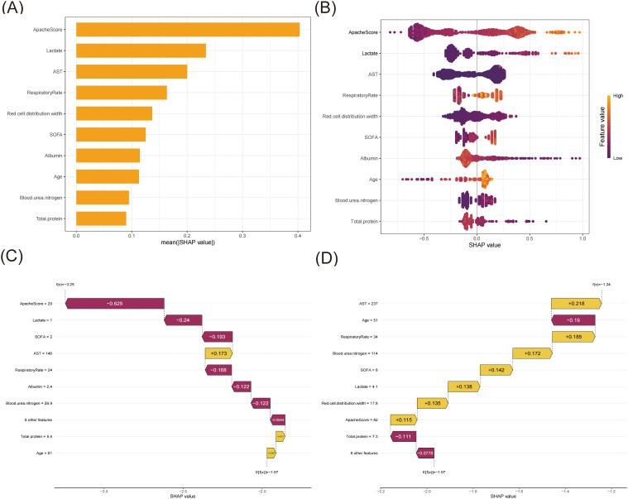
Shen, Li, et al. "Interpretable Machine Learning-based Prediction of 28-day Mortality in ICU Patients with Sepsis: A Multicenter Retrospective Study." Frontiers in Cellular and Infection Microbiology, vol. 14, 2025, p. 1500326, https://doi.org/10.3389/fcimb.2024.1500326. Accessed 2 Feb. 2026.
The SHAP analysis of the XGBoost model. (A) A bar plot displaying the mean SHAP value for the top ten variables. (B) The beeswarm plots displayed the distribution of the top ten variables, with variable values represented by different colors. Each sample was represented by a colored point. The x-axis represented the SHAP value, while the color coding indicated the feature values. (C) SHAP waterfall plot for case 1. (D) SHAP waterfall plot for case 2.

Slide 18
Angelis, Dimitrios, et al. "Artificial Intelligence in Physical Sciences: Symbolic Regression Trends and Perspectives." Archives of Computational Methods in Engineering, 2023, p. 1, https://doi.org/10.1007/s11831-023-09922-z. Accessed 2 Feb. 2026.
Identification and analysis of novel variants in SARS-COV-2 genomes isolated from the Kingdom of Bahrain
Khalid M bindayna, Abdel Halim Deifalla, Hicham Ezzat Mohammed Mokbel
bioRxiv 2021.01.25.428191; doi: https://doi.org/10.1101/2021.01.25.428191
Finally, we fitted a Cox model With the output of the mathematically transformed covariates.
Theresultingmodelwasvalidatedusingconcordanceindex(C-index).The C-index for a survival model can be thought of as the weighted average of the áreas under time-specific Receiver Operating Characteristic (ROC) curves for 285 day survival
The two models used the same covariates and only differ in the transformations. Themodelswerecompared usingC-index,AUC(285days), log-likelihood,andAkaikeInformationCrite rion(AIC)[4].
ForCoxModelling,weused lifelinesversion0.25.7[8].
Overfitting occurs when an algorithm is “finely” trained on a specific dataset, which in turn results on high statistical errors when applied to a different dataset. In such case, the proposed algorithm becomes unsuitable for further use, or in other words, ungeneralizable To overcome this issue, various techniques have been proposed, such as hold-out, k-fold cross-validation, and regularization

Slide 19
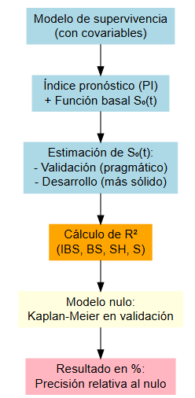
Rahman, M.S., Ambler, G., Choodari-Oskooei, B. et al. Review and evaluation of performance measures for survival prediction models in external validation settings. BMC Med Res Methodol 17, 60 (2017). https://doi.org/10.1186/s12874-017-0336-2
Medida | Qué evalúa | Cómo se calcula | Supuestos clave | Ventaja | Limitación
R² IBS (Integrated Brier Score) | Precisión promedio del modelo en todo el rango de tiempo | Basado en el Brier Score integrado sobre el tiempo | Requiere índice pronóstico y función de supervivencia basal | Resume desempeño global | Puede ser menos intuitivo para un tiempo específico
R² BS (Brier Score en un tiempo fijo) | Precisión en un punto temporal concreto (ej. 3 años) | Brier Score en un tiempo definido | Igual que IBS, pero en un solo tiempo | Fácil de interpretar clínicamente | Depende de la elección del tiempo
R² SH (Schemper-Henderson) | Varianza explicada por el modelo | Basado en log-verosimilitud y varianza | Asume modelo correctamente especificado | Tiene fundamento teórico sólido | Sensible a mala especificación del modelo
R² S (Song & Zhou) | Discriminación y calibración combinadas | Usa diferencias en supervivencia esperada | Requiere índice pronóstico y función basal | Integra varios aspectos del desempeño | Menos difundido, más complejo de explicar
Usar los datos de desarrollo para S₀(t) mantiene la integridad del modelo: la función basal es la misma que se habría usado en predicciones reales.
Usar los datos de validación es aceptable y da resultados muy similares (como reporta el artículo), pero conceptualmente mezcla información del modelo con datos externos.
Notes:
# Ejemplo de cálculo de IBS comparativo comparacion <- pec::pec( object = list("Modelo_Propuesto" = fit_cox), formula = Surv(tiempo, evento) ~ 1, # Modelo nulo (Kaplan-Meier) data = datos_validacion, reference = TRUE )

Slide 20
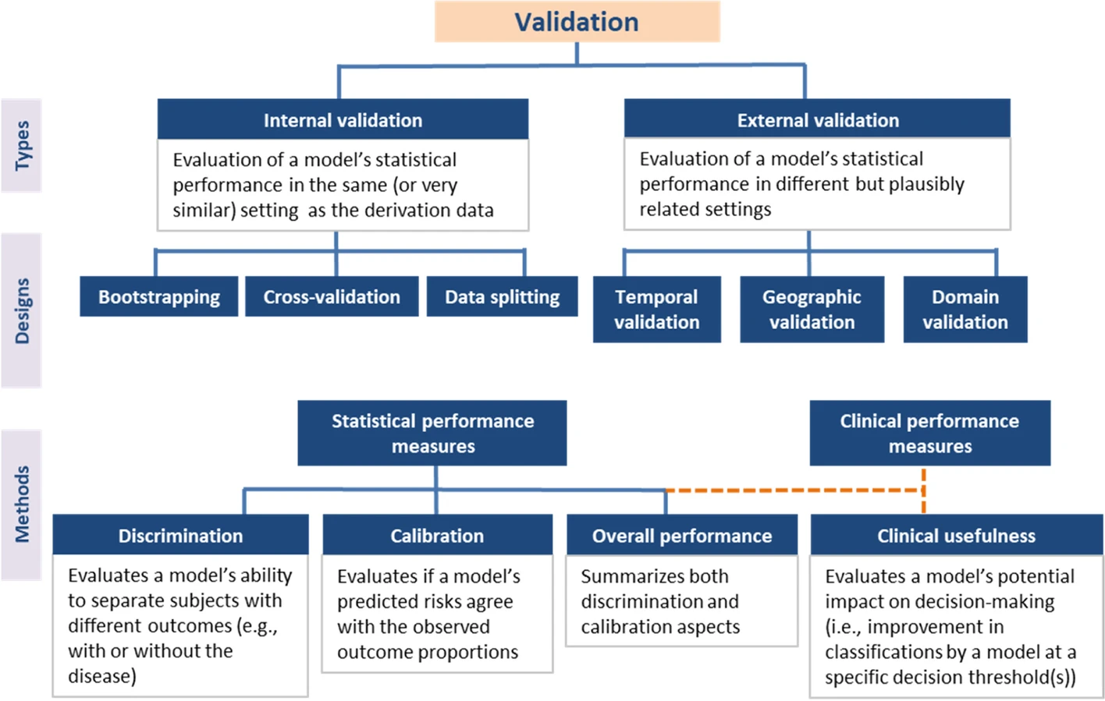
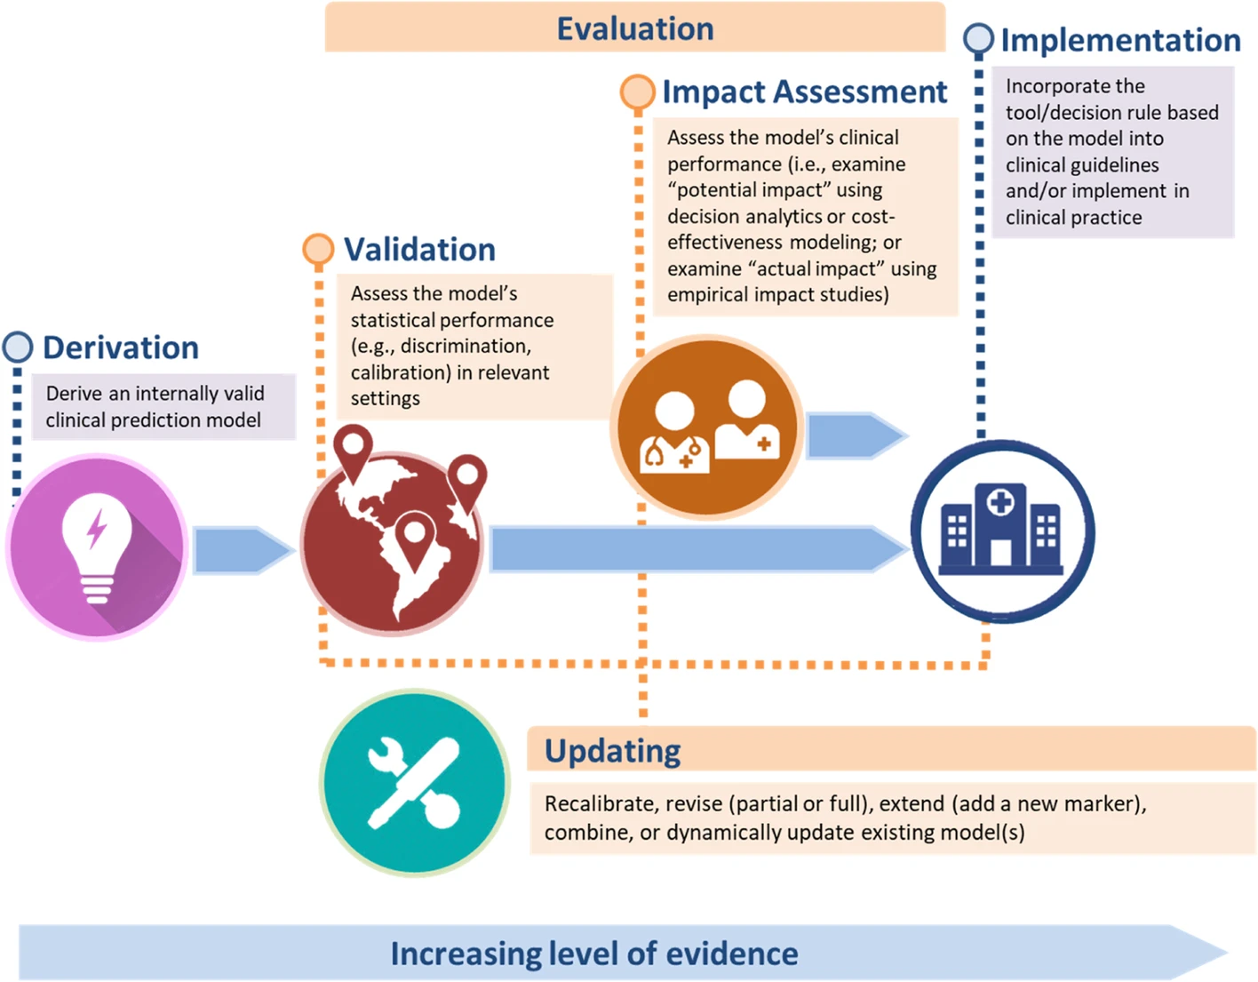
Binuya, M.A.E., Engelhardt, E.G., Schats, W. et al. Methodological guidance for the evaluation and updating of clinical prediction models: a systematic review. BMC Med Res Methodol 22, 316 (2022). https://doi.org/10.1186/s12874-022-01801-8
🩺 Clinical Usefulness (Utilidad clínica)
Evalúa el impacto práctico de un modelo en la toma de decisiones clínicas.
Complementa a discriminación y calibración (que son estadísticas), enfocándose en la relevancia clínica.
1. Medidas clásicas (dependen de un umbral):
Sensibilidad, especificidad, valores predictivos, exactitud.
Problema: dependen de la prevalencia del evento → no deben reportarse en aislamiento.
2. Medidas modernas (basadas en análisis de decisión):
Net Benefit (NB):
Combina beneficios y daños.
Penaliza falsos positivos frente a verdaderos positivos.
Más realista para evaluar impacto clínico.
Decision Curve Analysis (DCA):
Sensibilidad del NB a distintos umbrales.
Se visualiza en una curva de decisión.
Útil cuando no existe un umbral clínico universal.
Relative utility Curve
Variante del DCA.
Escala el NB comparándolo con la predicción perfecta.
3. Consideraciones prácticas:
Los umbrales aceptables pueden variar. Se recomienda análisis de sensibilidad
💰 Health Economic Analysis (Análisis económico en salud)
Evaluar el impacto potencial de un modelo en costos y beneficios clínicos.
Herramientas: modelos de decisión (Markov, árboles, simulaciones de costo-efectividad).

Slide 21
Avance a Marzo

Slide 22
Diagrama, cómo estructurar, Overview of key questions in prediction research
Section / Topic | Item | Dev / Val | Checklist Item
Title | 1 | D,V | Identify study as developing/validating a prediction model
Abstract | 2 | D,V | Summarize objectives, design, participants, predictors, outcome, analysis
Background & Objectives | 3a | D,V | Explain medical context and rationale
 | 3b | D,V | Specify objectives (development and/or validation)
Source of data | 4a | D,V | Describe study design or data source
 | 4b | D,V | Specify key study dates
Participants | 5a | D,V | Describe study setting
 | 5b | D,V | Describe eligibility criteria
 | 5c | D,V | Provide treatment details if relevant
Outcome | 6a | D,V | Define predicted outcome and assessment
 | 6b | D,V | Report blinding of outcome assessment
Predictors | 7a | D,V | Define predictors and measurement
 | 7b | D,V | Report blinding of predictor assessment
Sample size | 8 | D,V | Explain sample size determination
Missing data | 9 | D,V | Describe missing data handling
Statistical methods | 10a | D | Predictor handling
 | 10b | D | Model type and selection procedures
 | 10c | V | Prediction calculation in validation
 | 10d | D,V | Performance measures
 | 10e | V | Model updating methods
Risk groups | 11 | D,V | Creation of risk groups
Development vs Validation | 12 | V | Differences between datasets
Participants (Results) | 13a | D,V | Participant flow
 | 13b | D,V | Participant characteristics
 | 13c | V | Comparison with development data
Model development | 14a | D | Sample size & events per analysis
 | 14b | D | Unadjusted associations
Model specification | 15a | D | Full model presentation
 | 15b | D | How to use the model
Model performance | 16 | D,V | Report performance metrics
Model updating | 17 | V | Report updating results
Limitations | 18 | D,V | Discuss study limitations
Interpretation | 19a | V | Validation performance interpretation
 | 19b | D,V | Overall interpretation
Implications | 20 | D,V | Clinical use & research implications
Supplementary info | 21 | D,V | Availability of resources
Funding | 22 | D,V | Funding source & role
Background of a prediction study and state of science
What is the intended use of the prediction model?
What needs to be predicted, in whom, how and for what purpose (why)?
What prediction model is currently used in practice?
What is known about the predictors?
Is the study a development or validation study, or both?
Methodology
Is the study conducted in a sample of the target population?
Is the study design representative for the health care scenario?
Are the setting, location and dates (still) relevant?
Is the sample size / statistical power sufficient for the aim of the study?
Are the outcome and risk period clinically relevant?
Are all relevant predictors available?
Does the statistical model fit the data?
How are missing data and outliers handled? Are variables (re)coded in a meaningful way?
What method is used for reducing the number of variables in the model?
Assessment of prediction models
How well does the model fit the data?
What is the predictive ability of the model?
What is the discriminative accuracy of the model?
Validation of prediction models
How is the prediction model validated?
What is the model fit and performance in the validation study?
Assessment of clinical utility
How are risk thresholds chosen?
Does the use of the prediction model change medical decision making?
HACER PICOTS: PICOTS (Population, Index model, Comparator model, Outcome, Timing, Setting, and intended use of the prediction model) criteria
D/V= Development vs. validation
https://legacyfileshare.elsevier.com/promis_misc/XKME_TRIPOD_Guidelines_moreinfo.pdf

Slide 23
Desafíos y Calendarización
 |  | Febrero |  |  |  | Marzo
 |  | 2 al 8 | 9 al 15 | 16 al 22 | 23 al 28 | 2 al 8 | 9 al 15 | 16 al 22 | 23 al 29
Paper 2
 | Hacer BPMN
 | Esquematizar modelos
 | Poner a prueba
 | Discriminación
 | Calibración
 | Net benefit
 | Best subset
 | Análisis |  |  | x | x
 | DCA |  |  |  | x | x
 | Escribir paper 2 |  |  |  | x | x | x | x | x | x
 | Enviar paper 2 a coautores |  |  |  |  |  | x
 | Prep avance 2 |  |  |  |  |  |  | x
 | Presentación avance 2 |  |  |  |  |  |  |  | x
tesis
 | Discusión integrada
Actualizar la tesis con el paper 1
Ver predictors que agregué
Ver estratificaciones que no hice
Añadir imputación de datos, lógica, parámetros, etc., por qué es bueno para predicción, vars. descartadas, etc.
Para el modelo cox:
Hacer validación externa 70/30 (Data was split as 80% for training and 20% for validation.)
Considerar eventos CRxPlan
Modelo xgboost: explicarlo
Modelo Deep Hit: explicarlo
Generar el modelo cox alternativo
Validación 70/30 o 80/20 (buscar literature)
Balanceado CR x Plan (ver si eso conviene)
Usando modelo de Andersen, interpreter qué variables son importantes y predominan en cada resultado de tto.
Cuidado con los predictores ordinales. Tal vez los modelos no los toman bien
Modelo desarrollado en cohorte A
Evaluación (calibración + DCA) en cohorte B
Recalibración en B si es necesario (en train) ; DCA reportado en B
calibration slope [van Houwelingen] (we suggest prediction model is re-calibrated to the validation data before calculation of R2 PM to ensure that the survival times in validation data are used) (https://link.springer.com/article/10.1186/s12874-017-0336-2)

Slide 24
DUDAS
en base a lo que me indicas, que hice CV-SHAP, cómo explico cómo hice el feature selection?, parezco haberlo hecho en los datos de entrenamiento ? pero no entiendo muy bien CV entonces... porque me parece que están como entrelazados (ej., en un k- entrenamiento es prueba y viceversa, no?), entonces no sé si mi esquema puede separar bien lo que se hace arriba de lo que se hace abajo (ya cuando tengo los features candidatos para el modelo augmented/mejorado)
1.- exportar a _out/
2.- corregir from discharge
3.- poner el display de las bases
4.- el optuna debería tener fresh start, pero tomar el hyperparameter space de la expoloración exhaustiva
Añadir que el Deep Surv queda como sensibilidad porqe el SHAP no es CV , porque no existe

Slide 25
(*) Estratificado por:
Evento (readmisión / muerte)
Tipo de plan
Resultado de tratamiento (completa vs abandona)
(**) Evaluado a los 1, 3 y 5 años
ML para
selección
de
predictores
Búsqueda de hiperparámetros + ajuste XGBoost óptimo (según C de Uno y Brier Score):
– Algoritmo Optuna
Calcular valores SHAP
Predictores pre-establecidos
Días en tratamiento
Sust. prin. al ingreso . . .
Seleccionar los predictores más influyentes y consistentes (Detección de no-linealidad
e interacciones)
Entrenamiento (80%) (*) + SHAP mediante validación cruzada (k=5)
Unión
Eliminación de la correlación
(umbrales y puntos de corte = 0.9 /VIF >=10)
Modelos Cox para predicción
del riesgo
Ajustar un modelo Cox basal con predictores establecidos
h(t) = h₀(t) exp(a₁*_{Age at admission}+ a₂*_{days in treatment} + ...)
Ajustar un modelo Cox mejor informado, añadiendo nuevos predictores
h(t) = h₀(t) exp(b₁*_{Age at admission}+ b₂*_{days in treatment} + ...)
ev. no proporcionalidad
introducción de términos de ajuste
C de Uno Brier Integrado (IBS) Calibración Int.(ICI)** D₁
AICc
Prueba(20%)
Hacer predicciones desde un modelo Cox base
C de Uno
Brier Integrado (IBS)
Calibración Int.(ICI)**
D₁ AICc
Hacer predicciones desde un modelo Cox mejor informado
Recalibrar
DCA
Notes:
Ejecuta tu modelo CoxPH preliminar.
Pídele al software que calcule el GVIF de ese modelo.
Si alguna variable (o grupo de variables de Andersen) supera un valor comparable a un VIF de 3 o 5, vuelve a la literatura clínica clínica y decide cuál eliminar.
- Preprocesamiento y Colinealidad:
* Eliminación por correlación (>0.9) entre variables predictoras para limpiar la señal de los valores SHAP.
* Uso de GVIF (Generalized Variance Inflation Factor) antes del modelo Cox tradicional. Se busca GVIF^(1/(2*df)) al cuadrado < 3 (ideal) o < 5 para evitar que la multicolinealidad infle los errores estándar y arruine la inferencia clínica.
(*) Se generó una división reproducible persona‑nivel 80/20 entre desarrollo y prueba utilizando una estratificación jerárquica basada en plan de tratamiento, estado de finalización del tratamiento, reingreso y eventos de mortalidad, con el fin de preservar la prevalencia de los desenlaces y la distribución del caso‑mix. Estratos poco frecuentes se colapsaron progresivamente para asegurar un tamaño mínimo de celda de dos observaciones. Los mismos índices de división se aplicaron de manera consistente en todas las imputaciones múltiples.

Slide 26
ML-guided
predictor
discovery and
specification
Hyperparameter tuning + optimal XGBoost (based on Uno’C & Brier Score):
– Optuna algorithm
Calculate SHAP values
Pre-specified candidate predictors
Days in treatment
Tr. outcome
Primary substance at admission . . .
Select most consistent and influential predictors (Non-linearity & interactions)
Training (80%) (*)
Combined candidate predictor set
Collinearity screening
(thresholds = 0.9 /GVIF >=10)
Cox models for risk prediction
Base Cox with established predictors
h(t) = h₀(t) exp(a₁*_{Age at admission}+ a₂*_{days in treatment} + ...)
Performance
metrics
ML-informed parsimonious Cox model
h(t) = h₀(t) exp(b₁*_{Age at admission}+ b₂*_{days in treatment} + ...)
Held-out test sample (20%)
Predict from better informed Cox model
Performance metrics
Predict from better informed Cox model
Optional recalibration
DCA
Notes:
Ejecuta tu modelo CoxPH preliminar.
Pídele al software que calcule el GVIF de ese modelo.
Si alguna variable (o grupo de variables de Andersen) supera un valor comparable a un VIF de 3 o 5, vuelve a la literatura clínica clínica y decide cuál eliminar.
- Preprocesamiento y Colinealidad:
* Eliminación por correlación (>0.9) entre variables predictoras para limpiar la señal de los valores SHAP.
* Uso de GVIF (Generalized Variance Inflation Factor) antes del modelo Cox tradicional. Se busca GVIF^(1/(2*df)) al cuadrado < 3 (ideal) o < 5 para evitar que la multicolinealidad infle los errores estándar y arruine la inferencia clínica.
(*) Se generó una división reproducible persona‑nivel 80/20 entre desarrollo y prueba utilizando una estratificación jerárquica basada en plan de tratamiento, estado de finalización del tratamiento, reingreso y eventos de mortalidad, con el fin de preservar la prevalencia de los desenlaces y la distribución del caso‑mix. Estratos poco frecuentes se colapsaron progresivamente para asegurar un tamaño mínimo de celda de dos observaciones. Los mismos índices de división se aplicaron de manera consistente en todas las imputaciones múltiples.

Slide 27
Cox Net (Elastic Net) (Feb26)
Variables que afectan la discriminación
Readmision:
Plan Residencial GP
Etnia
Mujer
Sus. ingreso= Alcohol
Plan Residencial Mujeres
Sus. ingreso= Marihuana
Edad ingreso
Nivel educacional (inestable)
Abandono por violación de reglas (inestable)
Mortalidad
Edad
Sus. Ingreso= alcohol
Diagnóstico com. física
Frecuencia consumo sus. principal (diaria) (inestable)
Ev. ocupacional al egreso (inestable)
Condición ocup., desempleado (inestable)
Ev. física al egreso (inestable)
λ ( α Σ |βⱼ| + (1 − α) Σ βⱼ² )
Hyperparameter tuning
Regla 1- Error Estándar (SE)= Modelo con mayor penalización que se encuentre 1-SE del mejor modelo en discriminación Hastie, Tibshirani, & Friedman, 2009)
Validación interna, equilibrio por evento y tipo de plan, K=10 x M=5
Discriminación Uno-C
Combinaciones por Penalización (alfa/lambda) y Tipo de penalización (L1/L2)
Readmisión= λ=0.0028 (baja penalización), L1=0.1 (++ Ridge), Uno-C= .6085
Mortalidad= λ=0.00260 (L1=0.1), Uno-C=.7449
Notes:
Hastie, T., Tibshirani, R., Friedman, J. (2009). The Elements of Statistical Learning. Springer Series in Statistics. Springer, New York, NY. https://doi.org/10.1007/978-0-387-84858-7

Slide 28
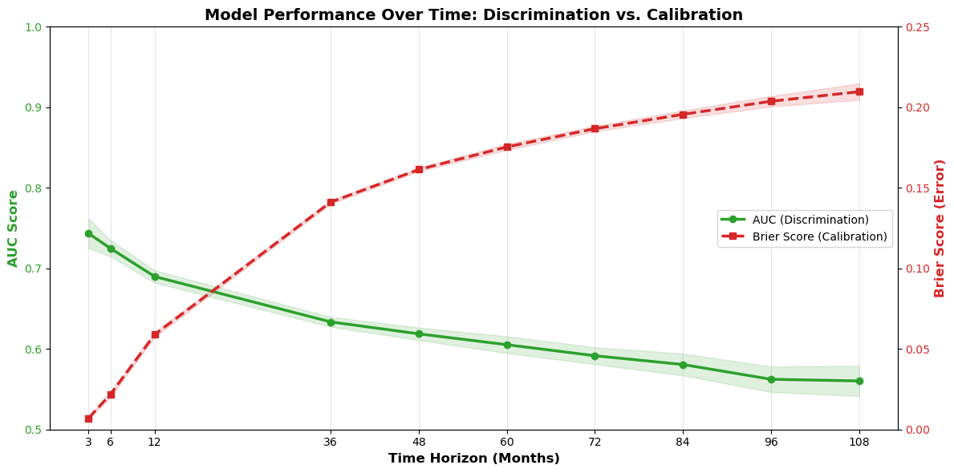
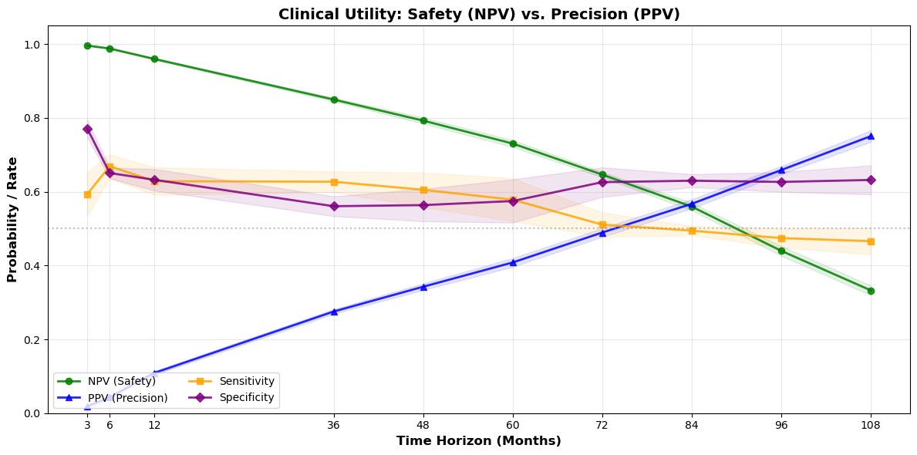
Cox Net (Elastic Net) (Feb26) (2)
Por ventanas de tiempo
Readmisión
Discriminación/estratificación temprana(AUC ~0.74 at 3 months)
Descarta riesgo (NPV) + que identifica (1/10 PPV al año)
Sensibilidad ~0.70 a los 6 meses
AUC ~0.69–0.74 al año
Disminuye a largo plazo (AUC ~0.56, 9a)
Discriminación pierde relevancia 3+añs
Error de calibración incrementa con el tiempo
El modelo se vuelve conservador y sistemáticamente infraestima.
Desde los 3 años en adelante
Evidentes variables tiempo-dependientes no observadas o no capturadas
Notes:
Hastie, T., Tibshirani, R., Friedman, J. (2009). The Elements of Statistical Learning. Springer Series in Statistics. Springer, New York, NY. https://doi.org/10.1007/978-0-387-84858-7 ES

Slide 29
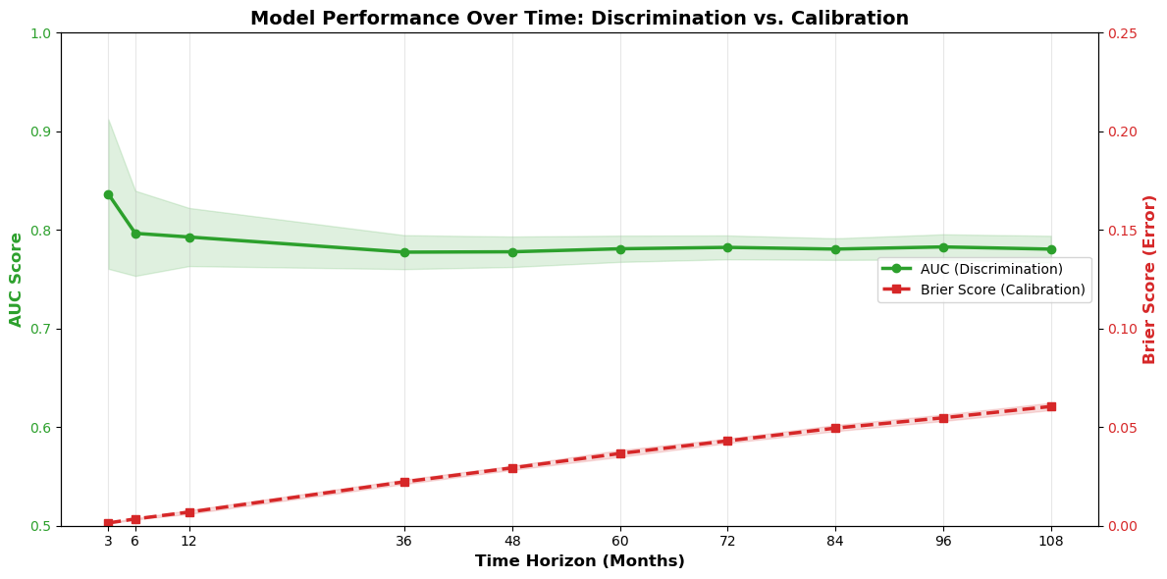
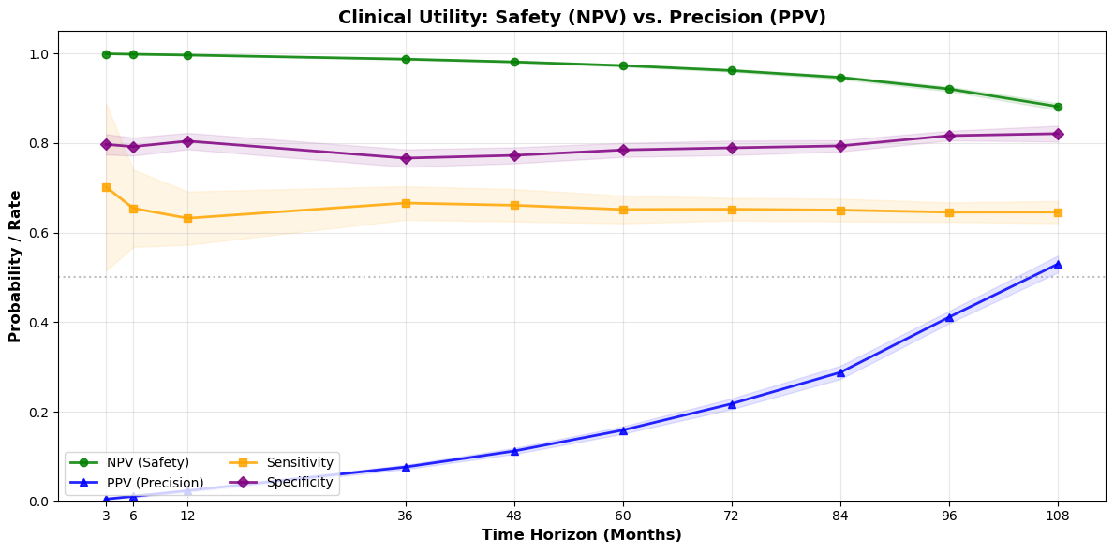
Cox Net (Elastic Net) (Feb26) (3)
Mortalidad
Discriminación/estratificación estable
Separa bajo-alto riesgo
Descarta riesgo (NPV) + que identifica (1/10 PPV)
Hasta los 6 años , leve subestimación; bajo error.
Esperable= mortalidad ocurre poco
Pero sensibilidad ~.65 (captura 2/3 fallecimientos) y especificidad ~0.80 (1/5 falsos positivos)
Notes:
Hastie, T., Tibshirani, R., Friedman, J. (2009). The Elements of Statistical Learning. Springer Series in Statistics. Springer, New York, NY. https://doi.org/10.1007/978-0-387-84858-7

Slide 30
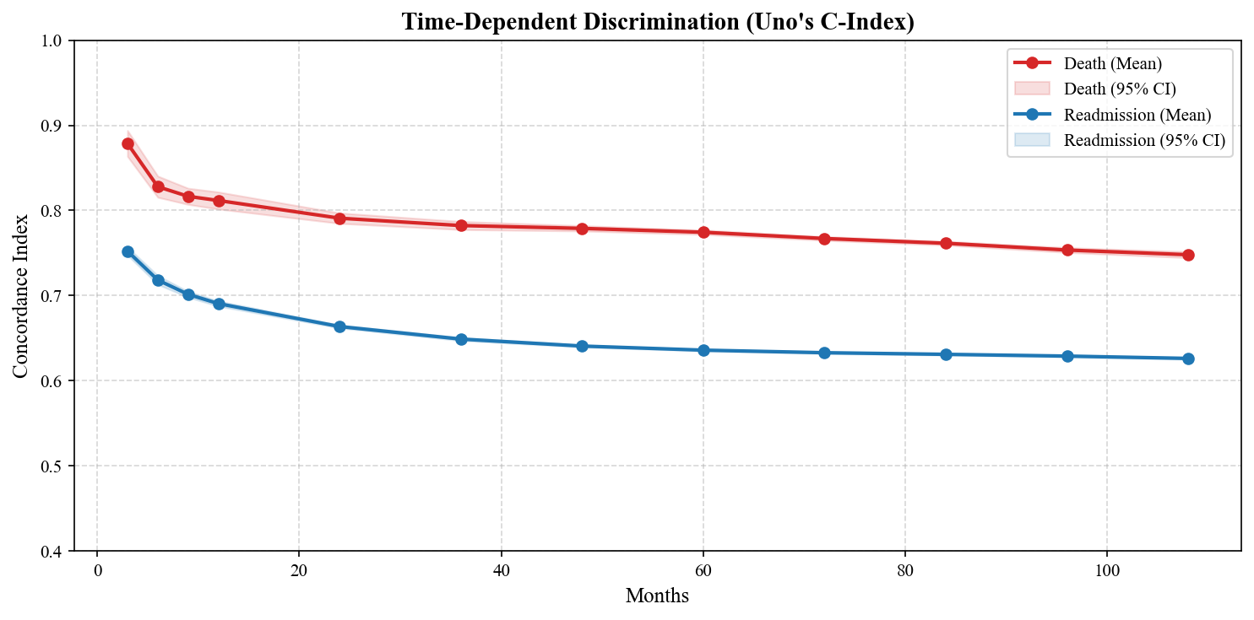
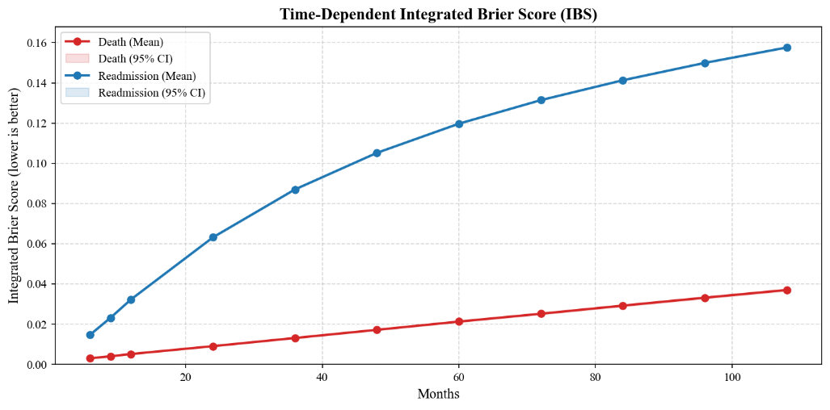
Modelo no-lineal ML (XGBoost)
Hiperparámetro | READM | Mortalidad | Interpretación breve
learning_rate | 0.02 | 0.01 | Mortalidad aprende más lento
max_depth | 6 | 4 | Reingreso más complejo
min_child_weight | 20 | 1 | Reingreso evita ruido
reg_alpha | 0.1 | 0.0 | Selección solo en reingreso
reg_lambda | 5.0 | 1.0 | Reingreso más regularizado
subsample | 0.8 | 0.6 | Mortalidad más aleatorio
colsample_bytree | 0.7 | 0.8 | Mortalidad usa más variables
gamma | 0.5 | 0.1 | Reingreso más conservador
Liu, Morelli, Littlejohns et al. 2023= “extreme gradient boosting” (XGBoost), aprende scores de riesgo (no tiempos al evento, sino log-hazards) en base al modelo Cox (optimiza partial likelihood) mediante secuenciales árboles pequeños de decisión, no maneja del todo riesgos competidores (solo corregimos la censura de la readmission por fallecimiento), sin asociaciones tiempo-dependientes.
Parameter tuning: Probamos distintos parámetros para mejorar la capacidad de discriminación (Uno’s C-index), para cada uno de los desenlaces.
Generamos modelos por separado siguiendo los hiperparámetros que mejoraban la discriminación de cada desenlace
https://agscl.github.io/DSPUCH/XGboost_readm_jan26.html
https://agscl.github.io/DSPUCH/XGboost_death_jan26.html
https://agscl.github.io/DSPUCH/XGboost_combined_jan26.html
Obtenemos para k(10) x m(5), métricas de rendimiento
Validación Cruzada Agregada sobre la imputación base: En lugar de seleccionar un único modelo representativo, calculamos los valores SHAP sobre el conjunto de validación de cada k y concatenado.
explicaciones para toda la cohorte basadas exclusivamente en predicciones 'fuera de muestra' (out-of-sample),
elimina sesgo de selección de un solo model
Validación cruzada estratificada por el tipo de plan + proporción del evento (evento observado vs. censura)
Evito Distributional Skew (folds sin eventos)
Vabalas, Andrius, et al. "Machine Learning Algorithm Validation with a Limited Sample Size." PLOS ONE, vol. 14, no. 11, 2019, p. e0224365, https://doi.org/10.1371/journal.pone.0224365. Accessed 6 Feb. 2026.
Riesgo | Métrica | Media ± DE
Mortalidad | IBS | 0.037 ± 0.002
Mortalidad | Uno’s C | 0.751 ± 0.011
Reingreso | IBS | 0.158 ± 0.001
Reingreso | Uno’s C | 0.623 ± 0.006

Slide 31
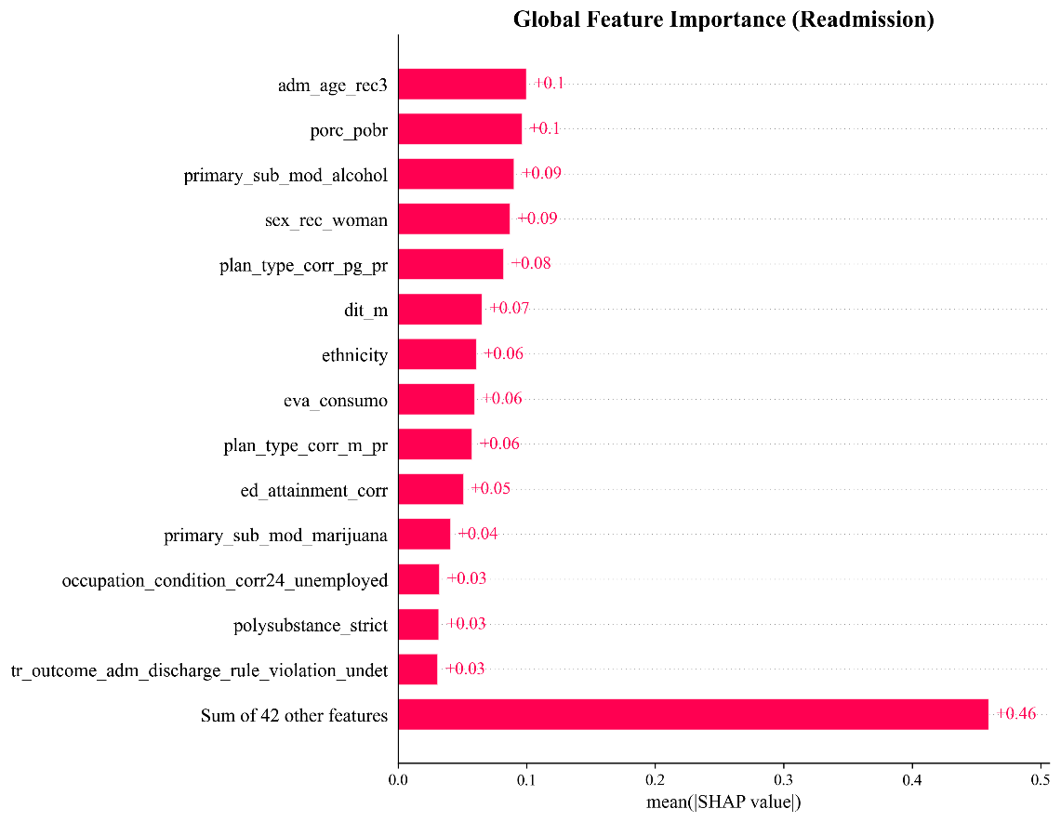
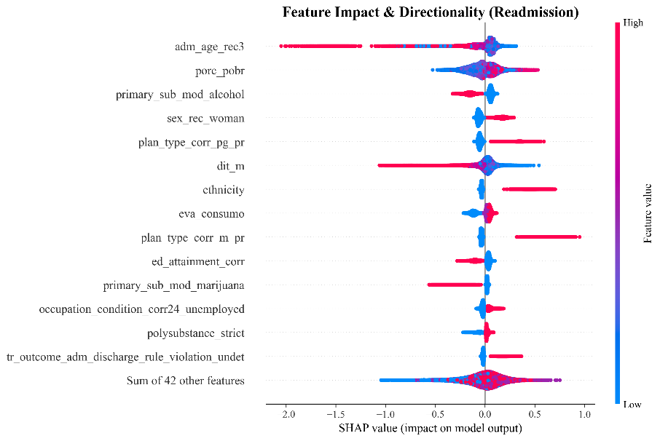
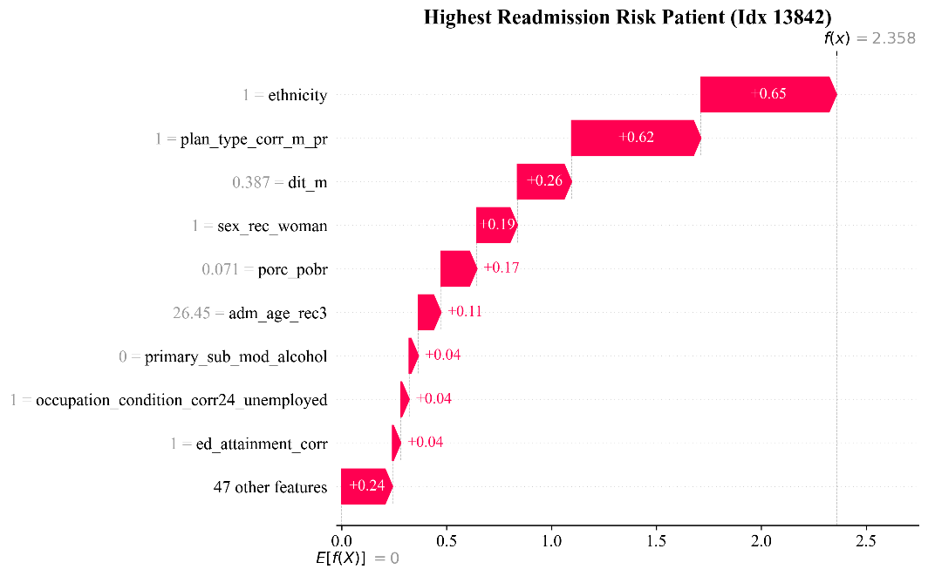
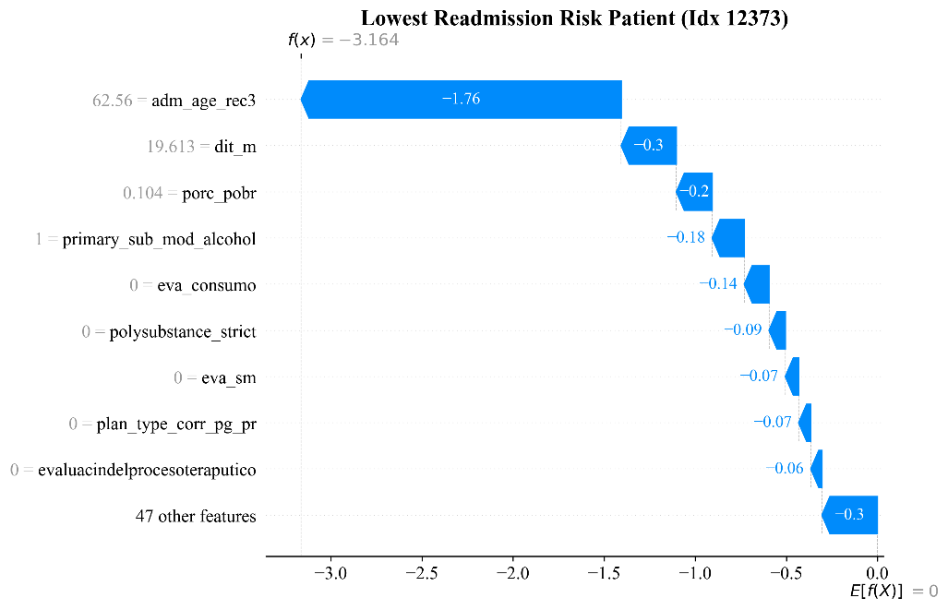
Modelo no-lineal ML (XGBoost)
Abrir la caja negra
SHAP con Validación Cruzada (CV-SHAP)
Importancia para c/paciente cuando eran validación
Elimina sesgo sobreajuste
Ranking, jerarquizar impacto global
Beeswarm: dirección efecto (vertical= importancia; horizontal= impacto= riesgo >0; color rojo, alto valor de la variable)
Cascada= paciente de mayor y menor riesgo (horizontal= riesgo; flecha roja= + riesgo evento; E[f(x)]= riesgo promedio población, cuánto se desvía de él

Slide 32
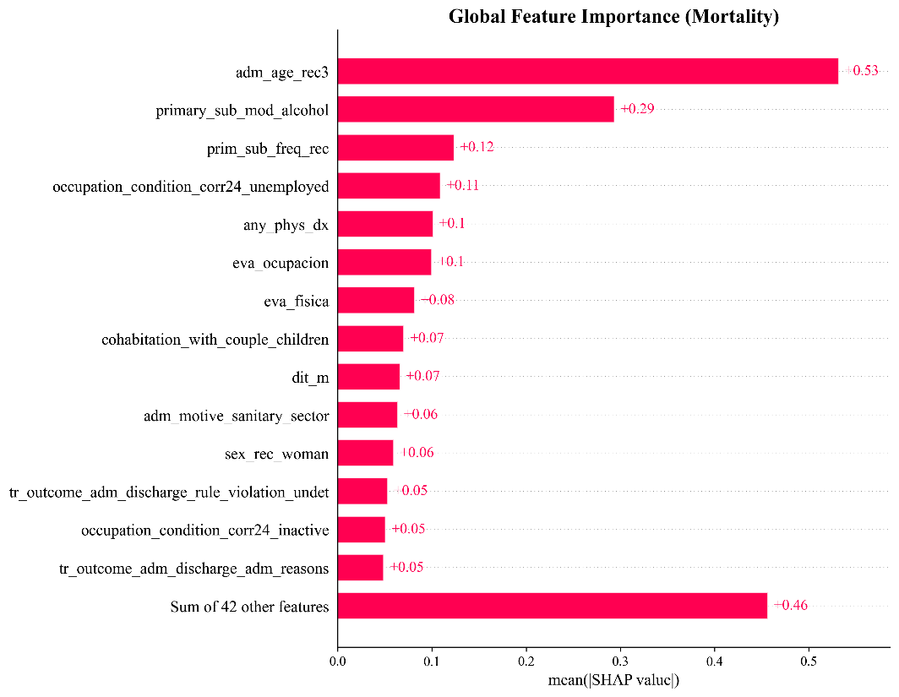
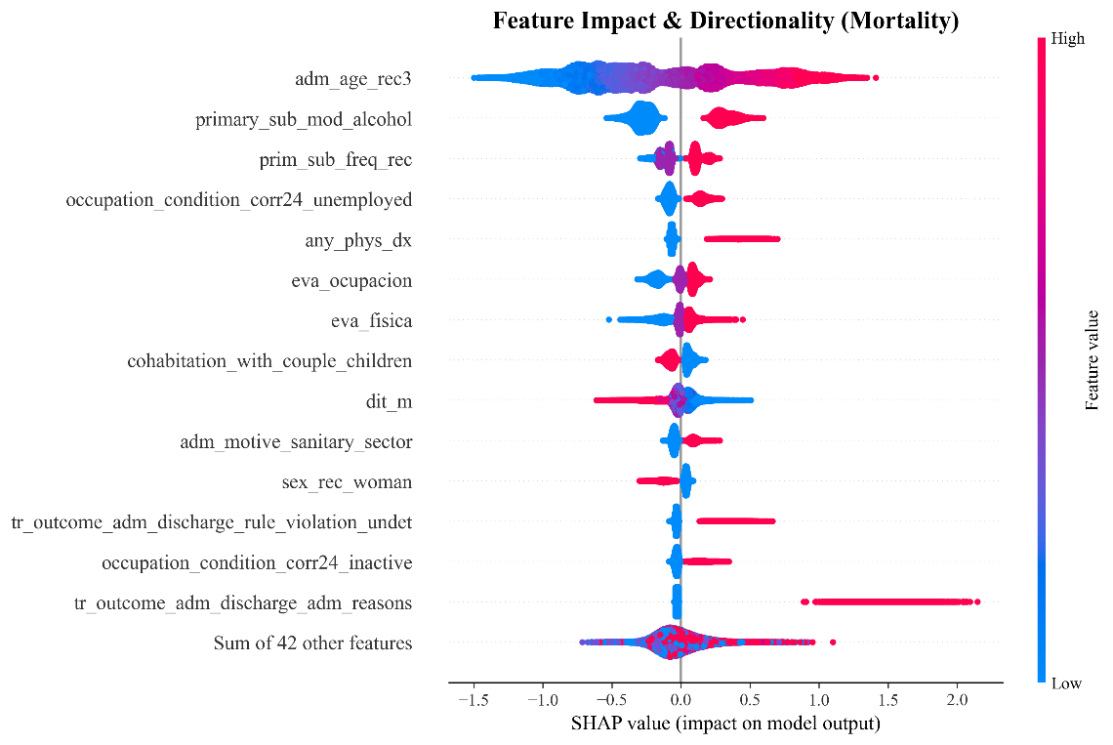
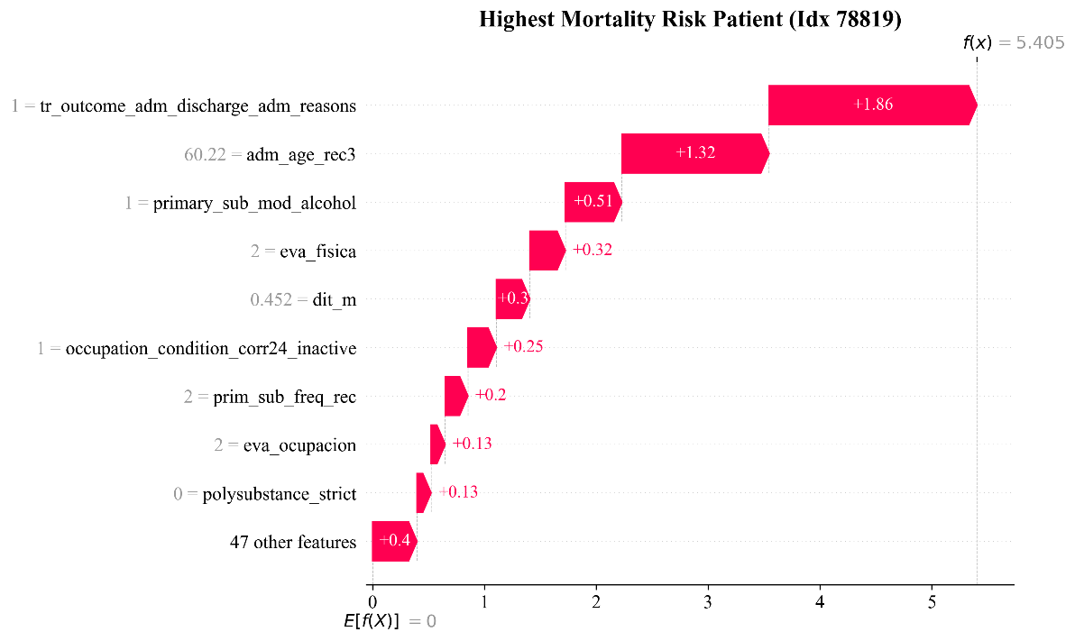
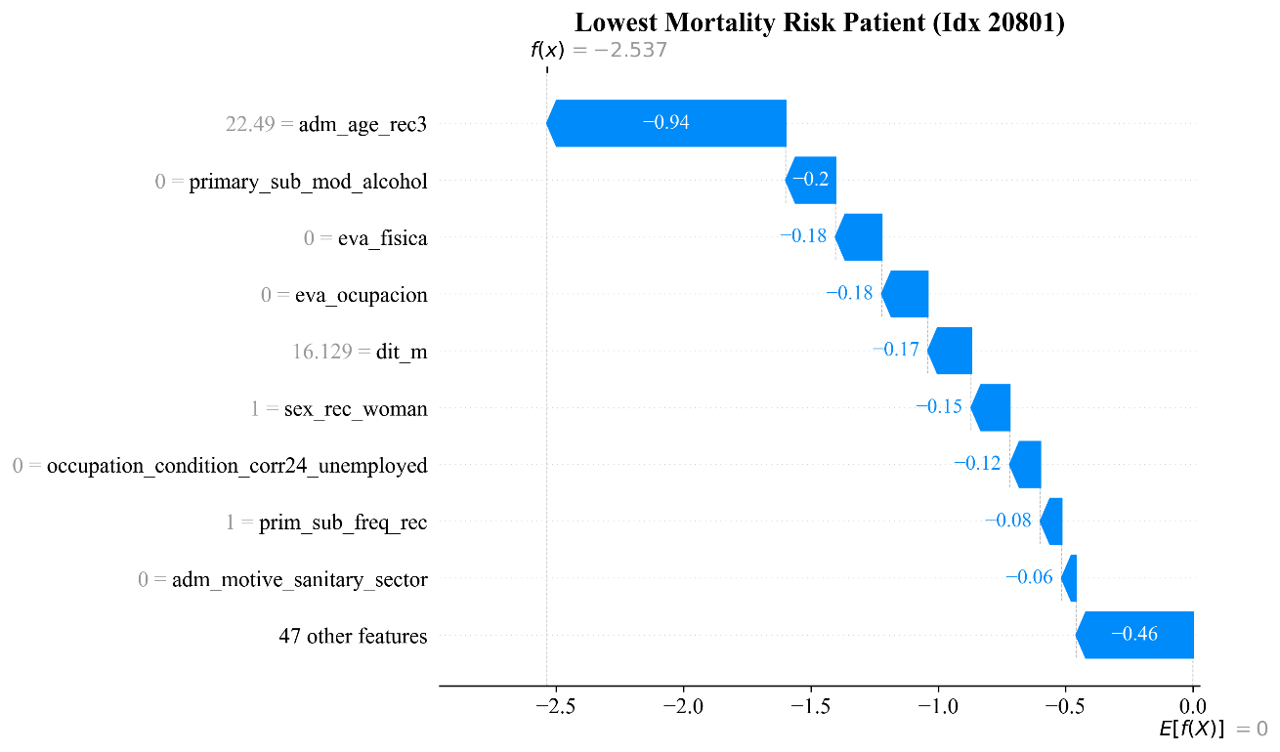
Modelo no-lineal ML (XGBoost)

Slide 33
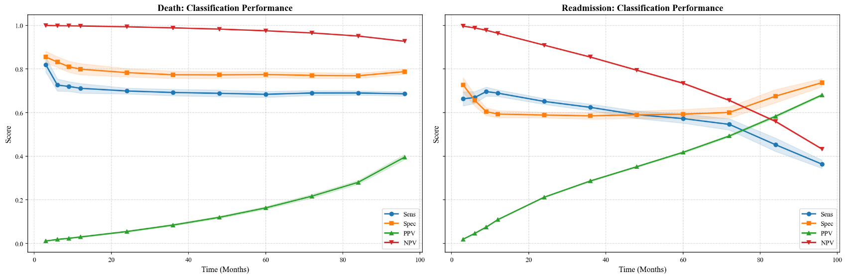
Modelo no-lineal ML (XGBoost)
Variable | Outcome | Forma | Especificación | Evidencia / Ajuste
Age (adm_age_rec3) | Death | Lineal estricta | Término lineal: age | Ajuste casi perfecto (R² ≈ 0.98)
Age (adm_age_rec3) | Readmission | No lineal (maturación) | Spline: pspline(age, df=4) | Cuadrático supera al lineal (R² ≈ 0.61 vs 0.32)
Poverty (porc_pobr) | Death | Umbral / escalonado | Categórica: cuartiles | Correlación lineal débil (R² ≈ 0.23)
Retention (dit_m) | Readmission | Rendimientos decrecientes | Log-transform: log(days) | No lineal > lineal (R² ≈ 0.67 vs 0.60)
Age | Readmission | Dispersión vertical | Términos de interacción | Interacción Age * Alcohol
Retention | Both | Cola larga / leverage | Winsorización / Log | Compresión de outliers (>24 meses)
Outcome | Tipo | Predictores clave (ordenados)
Mortalidad | Perfil de riesgo | 1. Age (Older) 2. Primary Substance: Alcohol 3. High Usage Frequency 4. Unemployment 5. Physical Comorbidities
Reingreso | Perfil de riesgo | 1. Poverty (Area-Level) 2. Female Sex 3. Plan Type (Specific Program Tracks) 4. Ethnicity (Mapuche) 5. Polysubstance Use
Mortalidad | Factores protectores | 1. Female Sex (Biological Resilience) 2. Treatment Retention (Clinical Dose) 3. Family/Partner Cohabitation (Social Support)
Reingreso | Factores protectores | 1. Older Age (Maturation Effect) 2. Primary Alcohol Use (The "Survivor Paradox") 3. Treatment Retention
Outcome de riesgo | Par de interacción | Fuerza
Mortalidad | Age * Alcohol Use | Muy alta (0.23)
Mortalidad | Unemployment * Inactivity | Alta (0.21)
Mortalidad | Age * Physical Health | Alta (0.19)
Mortalidad | Age * Cohabitation (Family) | Media (0.14)
Reingreso | Cocaine/Paste * Alcohol | Muy alta (0.22)
Reingreso | Plan Type * Female Sex | Alta (0.19)
Reingreso | Alcohol * Marijuana | Media (0.14)
Reingreso | Clinical Eval * Referral | Media (0.13)

Slide 34
XGB (actualizado a febrero)
Para readmisión, max_depth fue de 9, mortalidad de 3.
La complejidad de los árboles es exponencial (2^d): 2 vs. 512
Optimización de trayectorias más lenta: 0.0093 vs. 0.015 de mortalidad
Early stopping demora más (i.e., 700 vs. 1200-1500 rondas)
5CV , primero espacio amplio de búsqueda de hiperparámetros, luego restringido.
Sólo sobre la primera imputación
La estratificación considera tipo de plan, pero no asegura equilibrio explícito por evento
Notes:
La selección de los umbrales óptimos de decisión clínica se adaptó a la prevalencia y la naturaleza de cada riesgo competitivo. Para la Mortalidad, dado el marcado desbalance de clases (evento raro, incidencia acumulada <7%), el umbral se determinó maximizando el F1-Score. Este enfoque prioriza el equilibrio entre Sensibilidad y Valor Predictivo Positivo (Precisión), minimizando los falsos positivos en intervenciones de alta complejidad. Por el contrario, para la Readmisión, al presentar una mayor prevalencia sistémica (~30%), se utilizó el Índice de Youden para maximizar la discriminación global (Sensibilidad + Especificidad - 1), optimizando la capacidad del modelo para clasificar a la población general en protocolos de seguimiento estándar o intensivo.

Slide 35
DEEP HIT (Modelo CR, neural net, discretized follow-up times n=100)
https://fondecytacc.github.io/cons2025/DeepHit_jan26.html
Segundo intento (más robusto):
Maneja muerte y readmisión como competidores (10=k-CV x 5=M)
Probs. Aalen-Johansen (para manejar censura competitiva)
Intervalos en base a percentiles 2.5 y 97.5 de la distribución empírica
SHAP en múltiples intervalos de tiempo de seguimiento (hasta 6 años)
No hay Deep SHAP para tiempo al evento. Utilizamos Kernel SHAP (toma muestras aleatorias, no del todo representativas).
Validación cruzada por cada Mxk, concatenamos, generando un aprendizaje promedio y suavizando ruido por Mk’s
Red neuronal de supervivencia en tiempo discreto sin supuestos de riesgos proporcionales (Multilayer perceptrons - Oliver, Allou, Devineau et al., 2024).
Características:
Estimación flexible y no paramétrica de probabilidades.
Modela variables tiempo-dependientes y asociaciones no-lineales.
Ajuste de hiperparámetros (CV 5-fold, 100 intervalos [~1 mes], discriminación a 5 años):
Dropout 0.5: prioriza predictores robustos.
Capas [256, 256, 128]: para capturar no-linealidad e interacciones.
Alpha=.5 & Sigma=.5: igual importancia al ranking y al tiempo al evento.
Batch 1024: necesario para capturar eventos infrecuentes.
OJO= Puede que estos hiperparámetros no sirvan a readmisión.
https://fondecytacc.github.io/cons2025/DeepHit_jan26.html
Notes:
Oliver, M., Allou, N., Devineau, M. et al. A transformer model for cause-specific hazard prediction. BMC Bioinformatics 25, 175 (2024). https://doi-org.uchile.idm.oclc.org/10.1186/s12859-024-05799-2
Multi layer perceptron models outper-formed previous models in both continuous (DeepSurv) and discrete time (DeepHit) [10, 11].

Slide 36
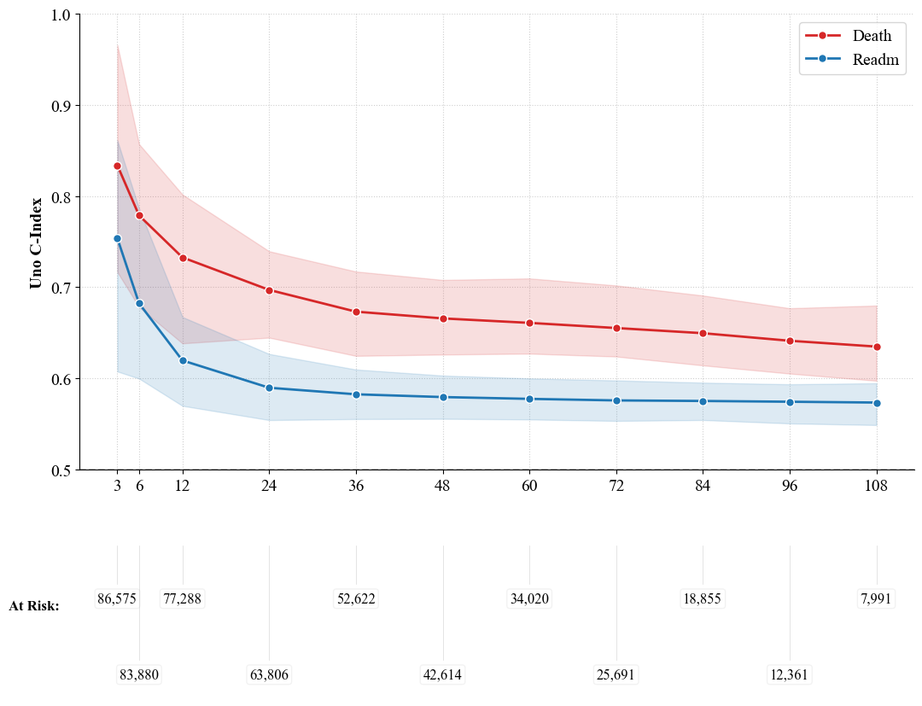
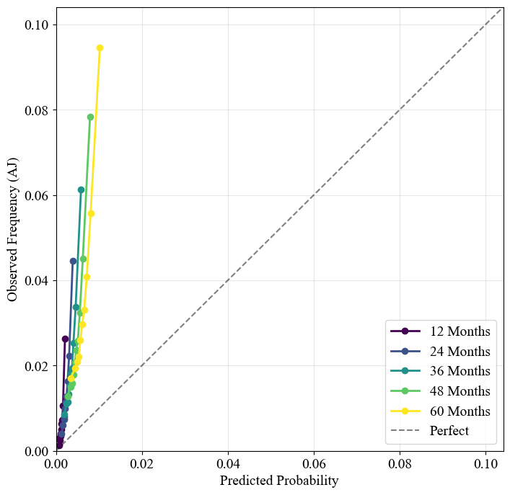
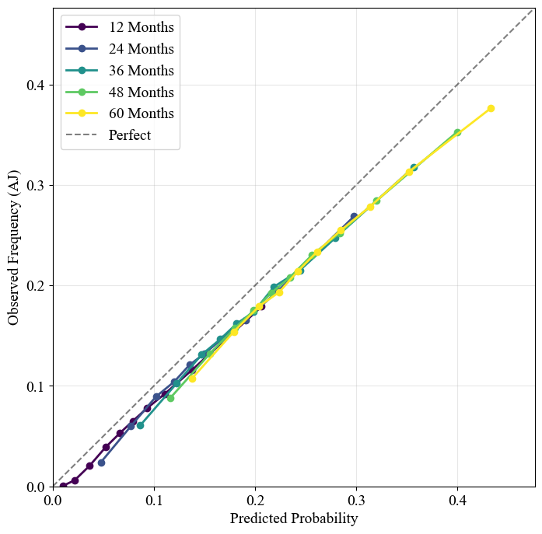
DEEP HIT (Desempeño)
Mortalidad= A los 3 meses (~0.8) y 12 meses (~.73), alta capacidad de ranking, mucha especificidad+NPV. Después de los 5 años, percibe riesgo, y dispara la sensibilidad (congruente= hyp tun hasta 5 años).
Subestima riesgo [sesgo conservador] (BS plot). Utilizar sólo para ordenar riesgo.
Readmisión= Más sensible (PPV), pero + error (baja NPV), >5 años, mucho error. A los 3 meses (~.73), 12m (.58-.60)
Predicción medianamente realista (BS~.26), sobreestima levemente el riesgo [alarmista] (BS plot)
En ambos= Primeros 5 años, alta especificidad, baja sensibilidad
Notes:
Si analizamos la discriminación y el Brier Score en el tiempo, vemos un fenómeno interesante explicado por la sensibilidad y especificidad del modelo.
Primeros 2 años, baja sensibilidad, se va a lo seguro (pocos eventos). Su especificidad y Valor Predictivo Negativo son cercanos al 100%. Acierta diciendo 'no'.
Pero a partir del mes 60, la realidad clínica cambia. El modelo nota el riesgo y cambia de estrategia: su sensibilidad se dispara por encima del 80%, pero su especificidad colapsa. Empieza a predecir muchos más eventos.
Esto explica los puntajes globales:
Para la mortalidad, como sigue siendo un evento poco frecuente, el Brier Score se mantiene bajo, pero a costa de un Valor Predictivo Positivo pobre. El modelo da muchas falsas alarmas de muerte.
Para la readmisión, que es mucho más frecuente a largo plazo, el Valor Predictivo Negativo cae drásticamente. El modelo ya no puede asegurar quién no será readmitido, lo que destruye su capacidad de discriminación (AUC) y dispara el Brier Score
al principio asume que "no pasa nada" (alta especificidad) y al final asume que "pasa todo" (alta sensibilidad)
Inicio: El modelo es Conservador (Sensibilidad 0, Especificidad 1). Solo dice "NO".
Final: El modelo es Alarmista (Sensibilidad alta, Especificidad baja). Empieza a decir "SÍ" a casi todo.
Tradicionalmente, en machine learning, si la probabilidad cruza el 50%, predecimos el evento. Nuestras curvas demuestran que eso aquí no sirve. Para detectar el riesgo a tiempo en la vida real, a veces basta con que el modelo detecte un 2% o un 19% de probabilidad, dependiendo del momento clínico.

Slide 37
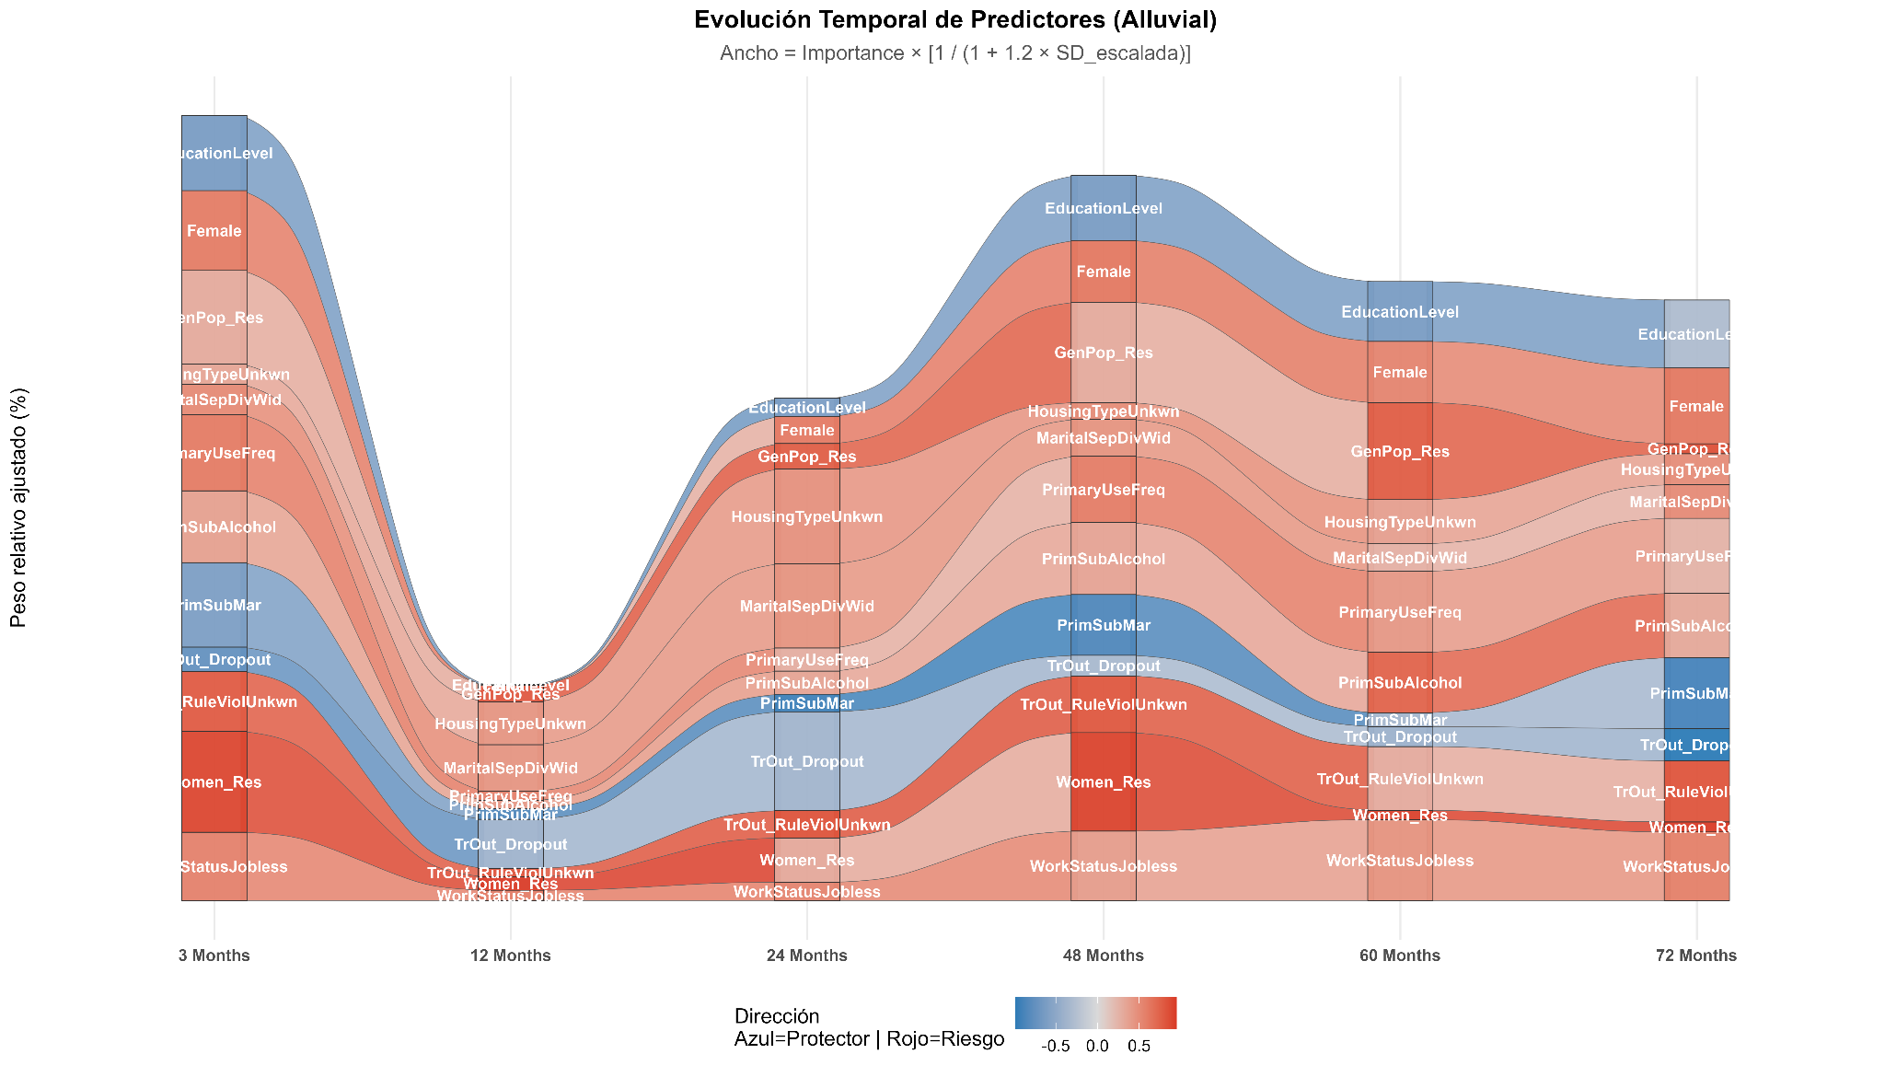
DEEP HIT (Predictores)
Evolución temporal de la importancia relativa de predictores de mortalidad
MORTALIDAD
Valores altos/presencia, aumenta riesgo
+Días en tratamiento (aumenta con el tiempo)
Etnia
Edad al ingreso (aumenta con el tiempo)
Plan residencial mujeres
Plan residencial población general
Desempleo
3-6 meses, sólo en ese período:
Ev. SM al egreso
Trastornos de Personalidad y Violencia/Abuso
Egreso por infracción de normas
2-3 años:
Dg. físico
Ev. rel. interpersonales
Frecuencia consumo
Ev. consumo al egreso
Dg. consumo CIE-10
Policonsumo
Valores bajos/ausencia, disminuye R
Niv. Educacional
Sus. principal, Marihuana
Origen ingreso, sector justicia
Notes:
En el fondo, el inverso proporcional de la variabilidad multiplicado por n factor = importancia relativa ajustada por estabilidad (penalización por variabilidad interindividual)
Este gráfico muestra la evolución relativa de los predictores más robustos del modelo a lo largo del tiempo, ponderando tanto su magnitud como su estabilidad, y permitiendo identificar cuáles factores permanecen estructuralmente relevantes y cuáles ganan o pierden importancia con el seguimiento.
Si hayun flujo ancho y sólido, es porque el modelo tiene mucha confianza en ese predictor.

Slide 38
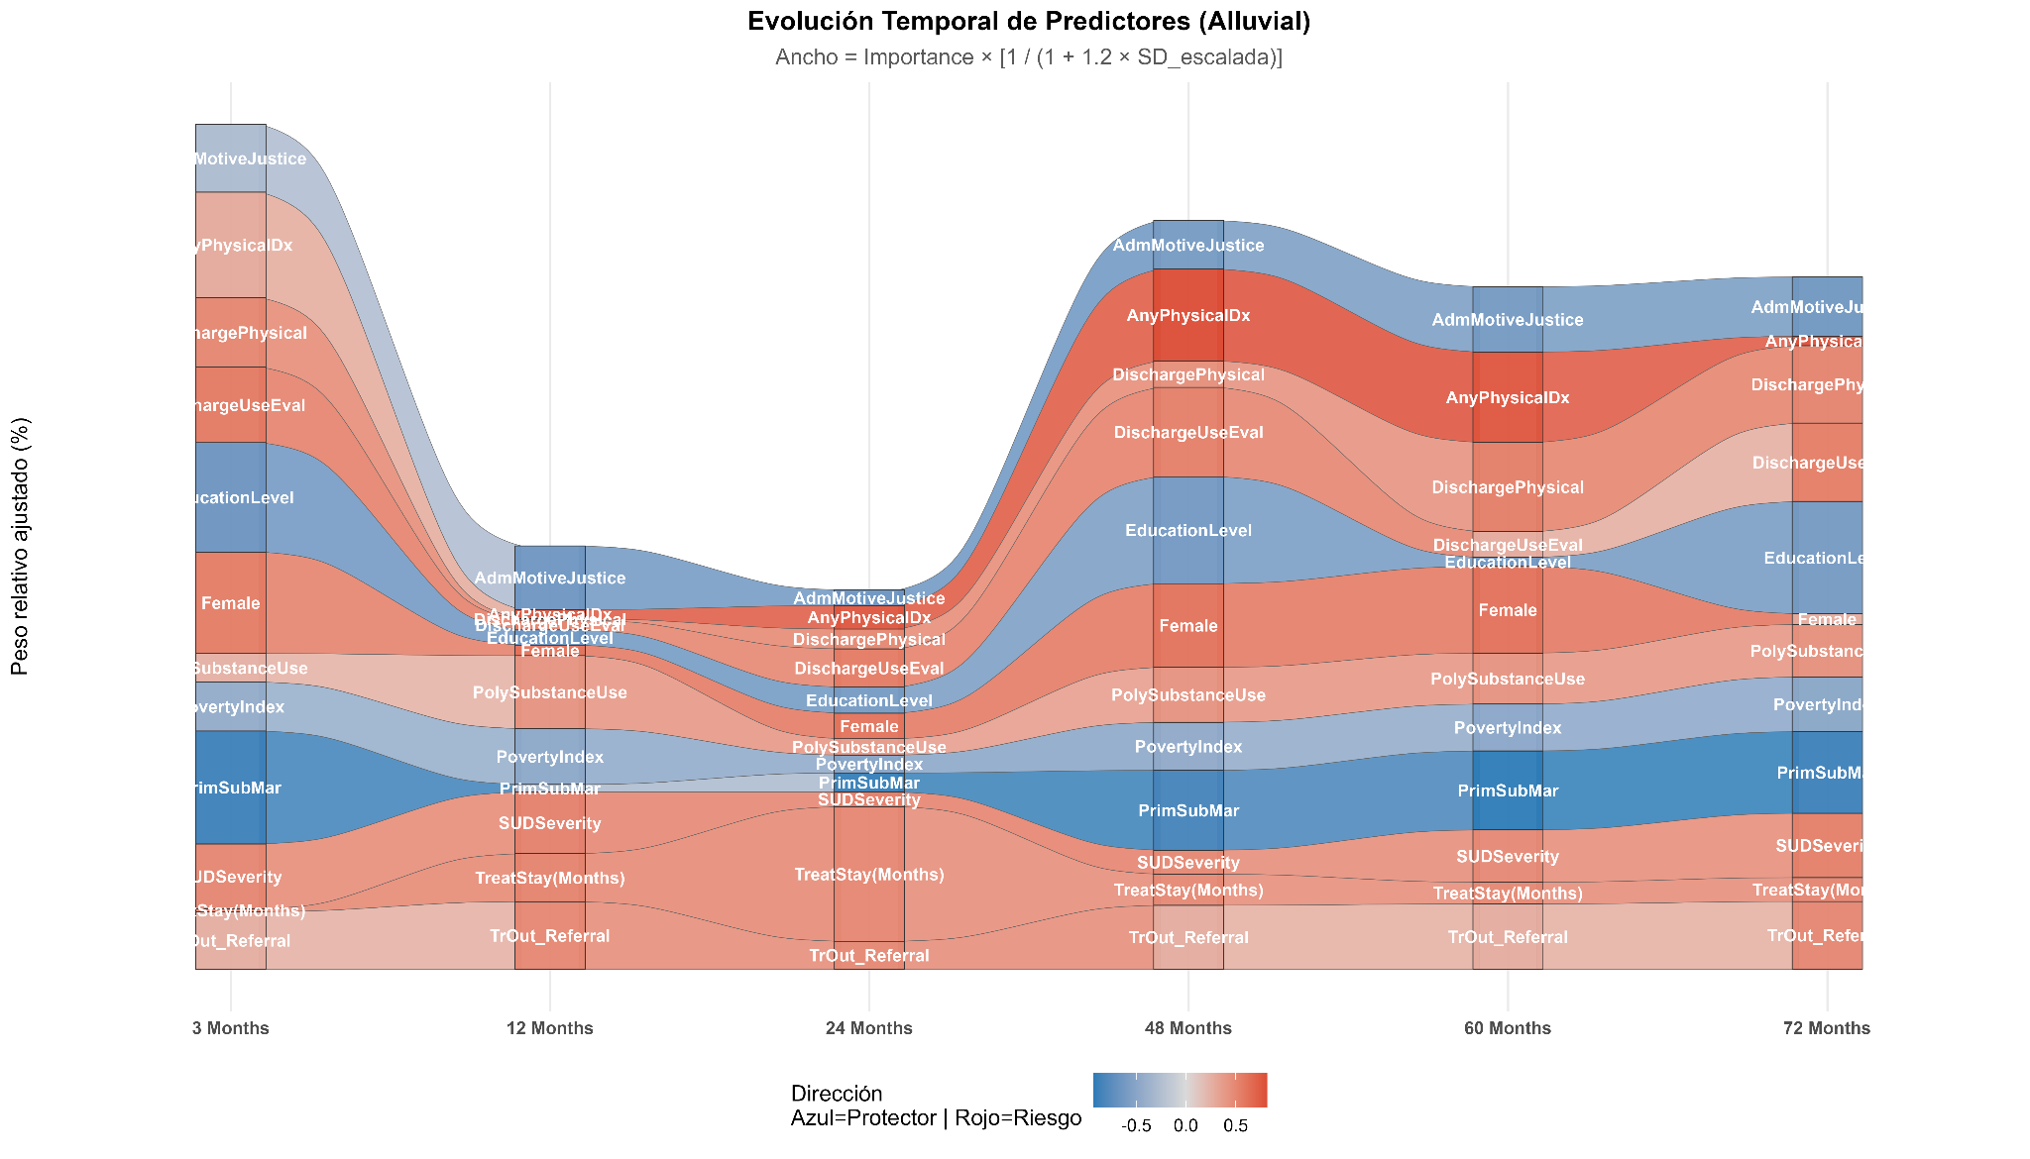
DEEP HIT (Predictores)
Evolución temporal de la importancia relativa de predictores de readmisión
READMISION
Valores altos, aumentan riesgo
Días en tratamiento
Etnia
Edad al ingreso
Plan Residencial (PG y M)
1-2 años:
El riesgo + heterogéneo
2-3 años:
Dg. físico
Frecuencia consumo
Ev. consumo
Severidad consumo
Policonsumo
Derivación (artefacto adm.?)
Valores bajos/ausencia, disminuye
Sus. principal, marihuana
Educación
Sus. principal, otras
Origen ingreso, justicia
Más movimiento a factores clínicos
Notes:
En el fondo, el inverso proporcional de la variabilidad multiplicado por n factor = importancia relativa ajustada por estabilidad (penalización por variabilidad interindividual)
Este gráfico muestra la evolución relativa de los predictores más robustos del modelo a lo largo del tiempo, ponderando tanto su magnitud como su estabilidad, y permitiendo identificar cuáles factores permanecen estructuralmente relevantes y cuáles ganan o pierden importancia con el seguimiento.
Si hayun flujo ancho y sólido, es porque el modelo tiene mucha confianza en ese predictor.

Slide 39
DEEP HIT (Interacciones)
Readmisión
Plan Res (M) * Separado/Div./Viudez
Plan Amb.Int. * Abandono por violación normas
Origen ingreso, justicia * Sus.Inicio, Cocaína
Ev. Rel.Int * Ev. proc. terapéutico
Ev. Rel.Int * Ev. Familia
Ev. Rel.Int * Ev. SM
Ev. consumo * Ev. proc. terapéutico
Nacionalidad(extranjero) * Abandono, violación normas
Sus.Inicio, Cocaína * Sus.Principal, Marihuana
Origen ingreso, FONODROGAS * Abandono por violación normas
Sus.Principal, Marihuana * Tipo vivienda (Otro)
Ev. consumo * Ev. SM
Ev. Familia * Ev. física
Origen ingreso, FONODROGAS * Sus.Principal, Marihuana
Cohabitación, otros * Plan Amb.Int. (M)
Sus.Principal, Marihuana * Origen ingreso, justicia
MORTALIDAD
Evaluación SM al egreso * Ev. Transgresión norma
Ev. Rel.Int * Ev. SM
Ev. Rel.Int * Ev. proc. terapéutico
Ev. Rel.Int * Ev. transgresión norma
Ev. Rel.Int * Ev. Familia
Plan Res (M) * Separado/Div./Viudez
Plan Amb.Int. * Abandono por violación normas
Tipo de vivienda, Otra * Res. tto., Otros
Origen ingreso, justicia * Sus.Inicio, Cocaína
Ev. consumo * Ev. familia
Nacionalidad(extranjero) * Abandono, violación normas
Sus.Inicio, Cocaína * Sus.Principal, Marihuana
Sus.Principal, Marihuana * Tipo vivienda (Otro)
Origen ingreso, FONODROGAS * Abandono por violación normas
Etnia * Plan Res (M)
Ev. física * Ev. transgresión norma
Sus.Principal, Pasta Base * Consumo(Dependencia)
Ev. Rel.Int * Ev. física
Ev. consumo * ev. física
Ev. consumo * Ev. proc. terapéutico
Plan Res (M) * Abandono por violación normas
Mortalidad= comorbilidad física x policonsumo
Mortalidad= Frecuencia consumo x Dg. comorbilidad física
Readmisión= Comorbilidad psiquiátrica x policonsumo.
Ambos= Frecuencia consumo x Abandono
Ambos= comorbilidad psiquiátrica x Etnia
Ambos= Frecuencia consumo x Dg. comorbilidad psiquiátrica
Notes:
En el fondo, el inverso proporcional de la variabilidad multiplicado por n factor = importancia relativa ajustada por estabilidad (penalización por variabilidad interindividual)
Este gráfico muestra la evolución relativa de los predictores más robustos del modelo a lo largo del tiempo, ponderando tanto su magnitud como su estabilidad, y permitiendo identificar cuáles factores permanecen estructuralmente relevantes y cuáles ganan o pierden importancia con el seguimiento.
Si hayun flujo ancho y sólido, es porque el modelo tiene mucha confianza en ese predictor.

Slide 40
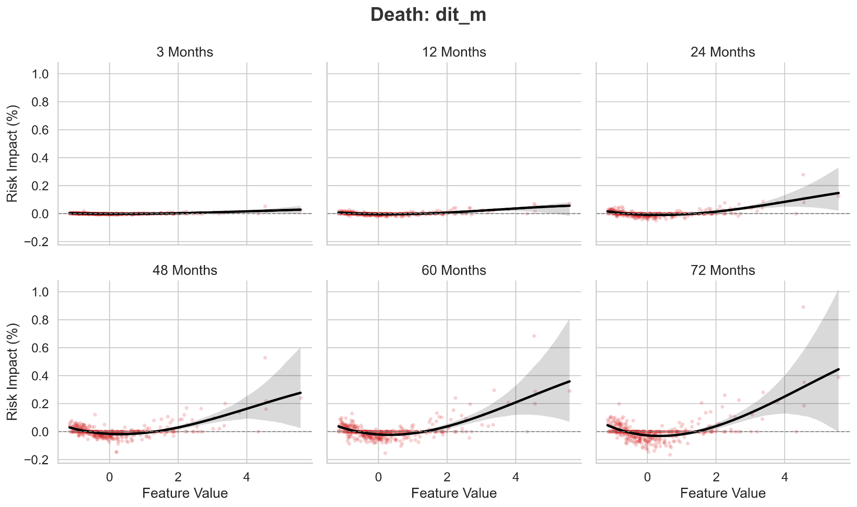
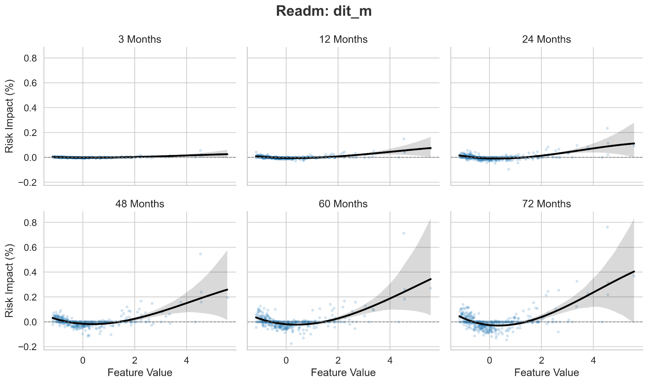
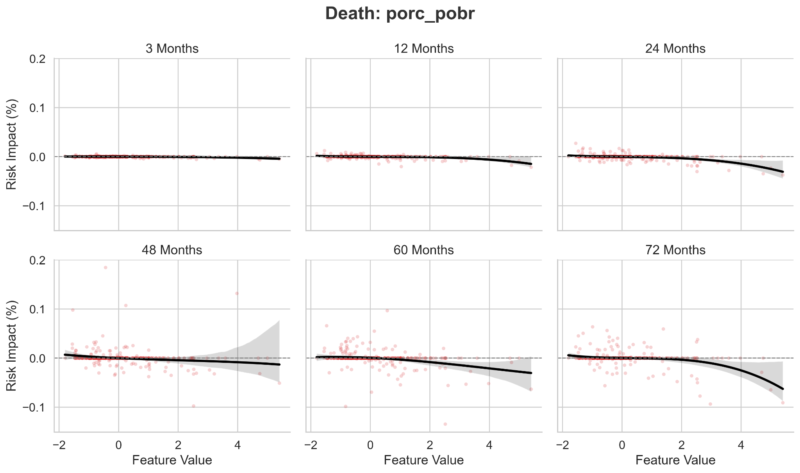
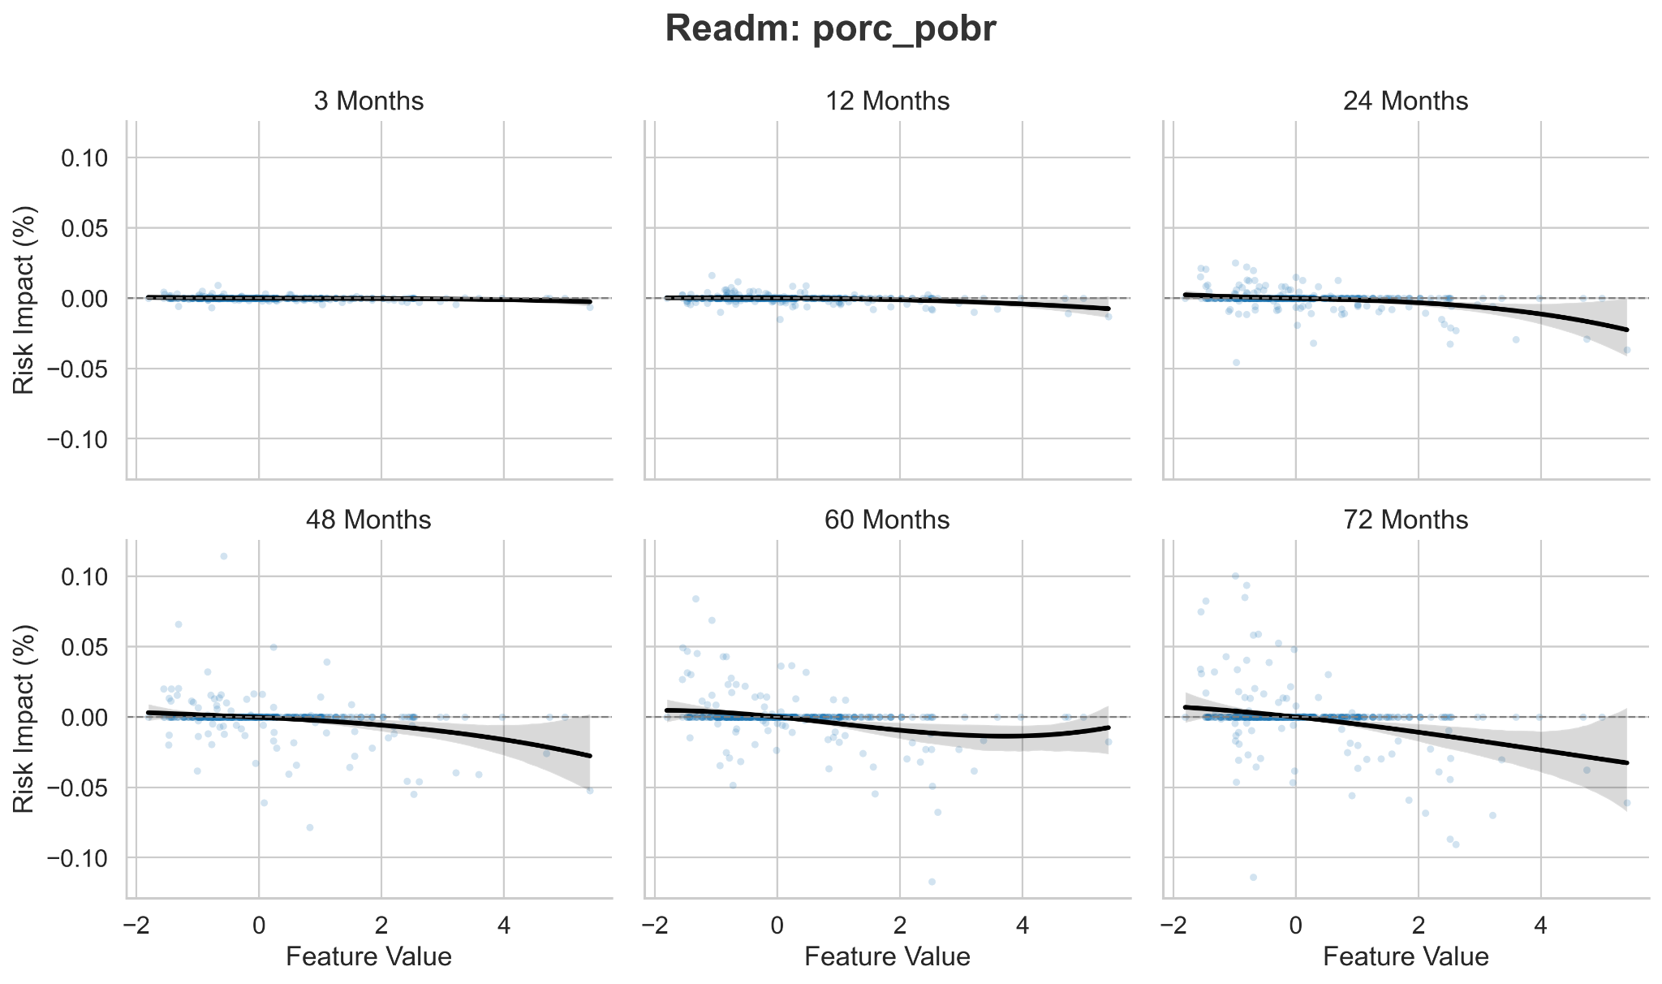
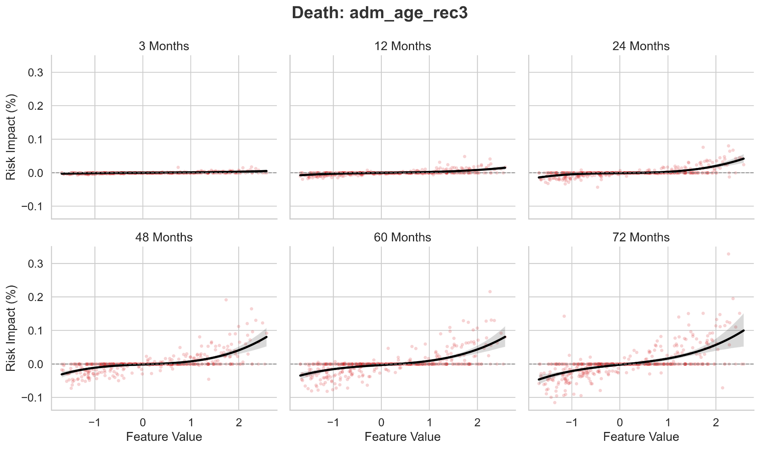
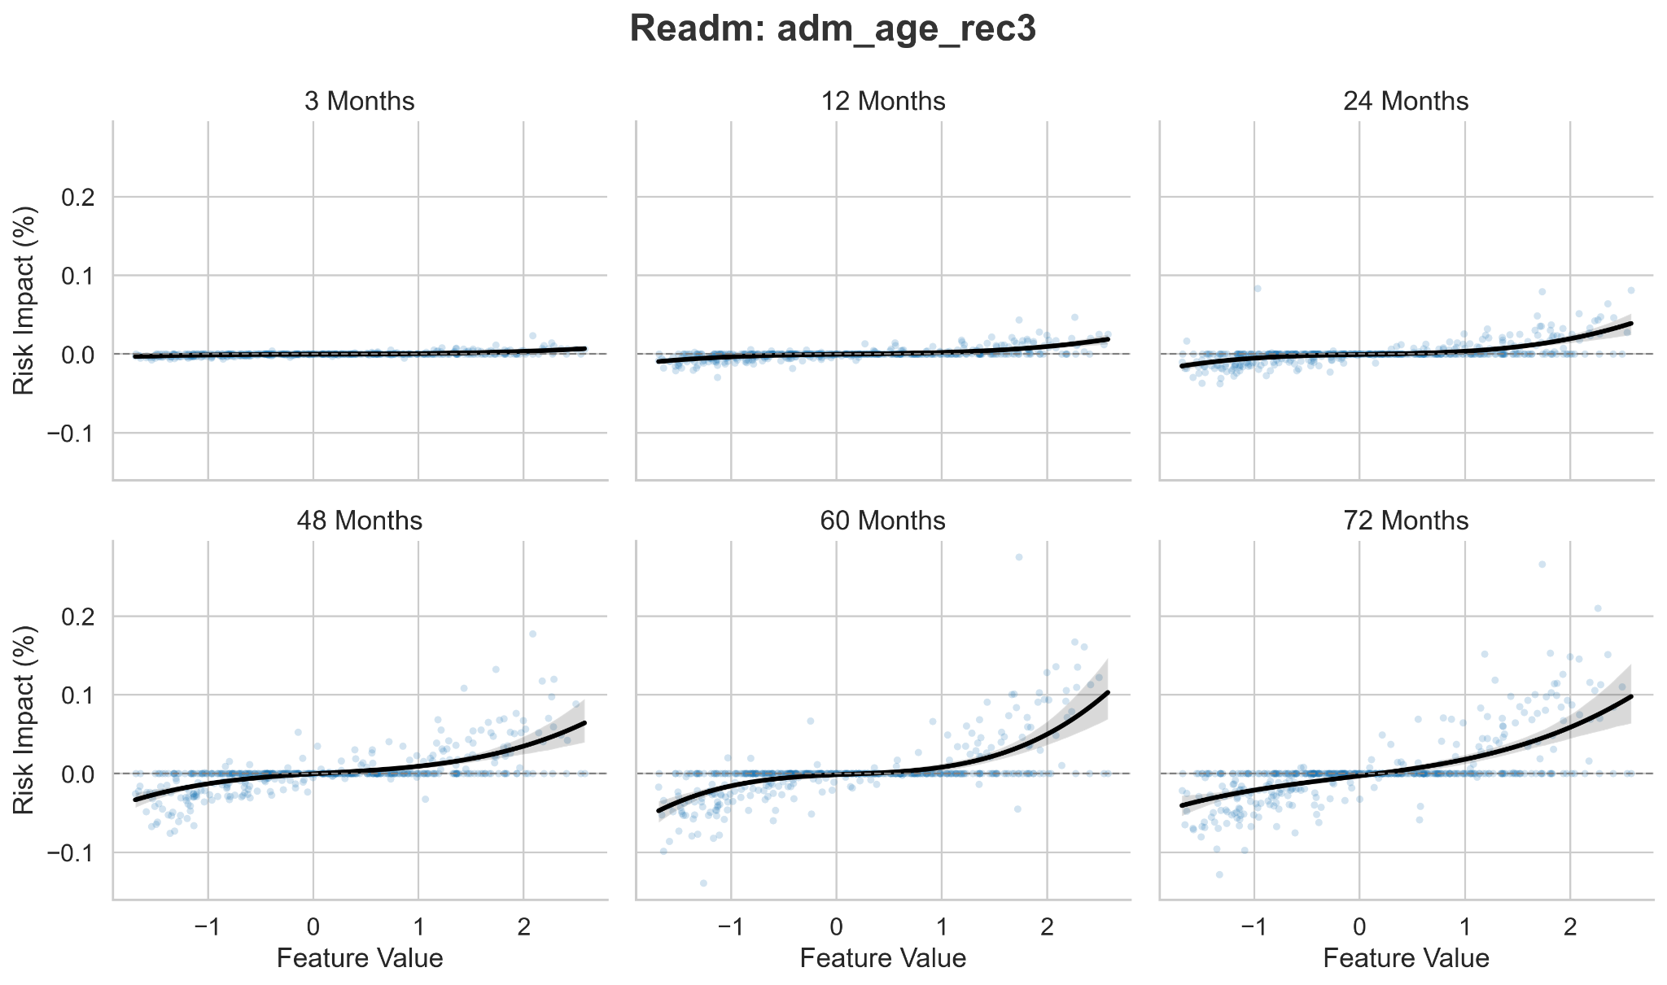
DEEP HIT (Forma fx)
Días en tto.
Distinto al anterior. Mirada más fina, protector primeros meses
Se estabiliza (decrece) a la mitad
Valores extremos crecientes:
Pacientes que permanecen muchísimos meses más complejos.
log(X + 1)
Pobr. multidim.
Índice más alto, protector (influencia negativa) de readmisión, 5 años en adelante
Sospecha un efecto umbral
Edad al ingreso
Incremento lineal, más parsimonioso. Aceleración a mayor edad= ^2
influencia mortalidad, influencia negativa en readmisión
Notes:
En el fondo, el inverso proporcional de la variabilidad multiplicado por n factor = importancia relativa ajustada por estabilidad (penalización por variabilidad interindividual)
Este gráfico muestra la evolución relativa de los predictores más robustos del modelo a lo largo del tiempo, ponderando tanto su magnitud como su estabilidad, y permitiendo identificar cuáles factores permanecen estructuralmente relevantes y cuáles ganan o pierden importancia con el seguimiento.
Si hayun flujo ancho y sólido, es porque el modelo tiene mucha confianza en ese predictor.

Slide 41
DEEP SURV(Modelo CR, neural net)
https://fondecytacc.github.io/cons2025/DeepSurv2_feb26.html
Cause-specific CoxPH, CV-k (estratificado plan x evento)=10, M=5,
Umbrales de clasificación aprendidos de los datos de entrenamiento
11 ventanas de seguimiento (de 3 meses a 9 años)
Umbral que max. F1 en folds de entrenamiento y aplico a validación (basados en sensibilidad y PPV [asume costos simétricos; probar maximizando J Youden para Mortalidad])
SHAP restringido a la primera base imputada
Pooling cruzado, SHAP en c/fold de validación (Pooling multi-fold), concatenado, más generalizable
Riesgo absoluto a un horizonte específico (3 a 96 meses)
📊 Evaluación
→ Uno C-index con IPCW
→ Con todo, Brier Score con ponderación IPCW basada en Aalen–Johansen.
Métricas sobre distribución empírica 95% (repeated-split, k x M)
Estimación flexible y no paramétrica de probabilidades.
Modela variables tiempo-dependientes y asociaciones no-lineales.
Ajuste de hiperparámetros (CV 5-fold, discriminación promedio a 1-5 años, readmisión + mortalidad), cause-specific Cox (censuramos eventos competidores) para riesgos competidores:
Primero, buscamos en 32 combinaciones de hiperparámetros. Luego, refinamos mediante una optimización dirigida Bayesiana Optuna (explora aprendiendo de los intentos previos)
Dropout 0.57: prioriza predictores robustos (ignora ruido, descartand 57% de las neuronas en training).
Capas [256, 256, 128]: para capturar no-linealidad e interacciones, 3 capas fue la forma óptima hallada para HRs (no-linealidad, pero no tan compleja).
Mecánicas de optimización: Tasa de aprendizaje loento a .0008 cn un batch de tamaño 1024. La señal predictiva se distribuye en varios factores de riesgo débiles-moderados
Búsqueda de hiperparámetros: primero grid search (32) — mejor C‑Index ≈ 0.76809; luego Optuna (Bayesiano) para refinar espacio, alcanzando mejor C‑Index ≈ 0.76963
Performance stabilized across higher-capacity architectures, suggesting diminishing returns from additional model complexity.
Notes:
Oliver, M., Allou, N., Devineau, M. et al. A transformer model for cause-specific hazard prediction. BMC Bioinformatics 25, 175 (2024). https://doi-org.uchile.idm.oclc.org/10.1186/s12859-024-05799-2
Multi layer perceptron models outper-formed previous models in both continuous (DeepSurv) and discrete time (DeepHit) [10, 11].
Parámetros fijados
1️⃣ Activación = ReLU, cada neurona hace f(x)=max(0,x) , efectos negativos fuertes se truncan en 0, redes estables y rápidas, evita saturación pero ve no-linealidad
2️⃣ batch_norm = True, normaliza las activaciones para cada etapa durante training (reduce inestabilidad)
3️⃣ Optimizer = Adam, Usa gradientes adaptativos con momento. Se usa porqe converge rápido
4️⃣ Betas de Adam (0.9, 0.999), cuánto recuerda gradientes pesados, y cuánto suaviza la varianza el gradiente (ven estabilidad vs. capacidad de adaptación).
5️⃣ epochs = 250, es un techo, early stopping manda,
6️⃣ Early stopping patience = 15, si el validation loss no mejora en 15 epochs consecutivos, se detiene, más conservador (evita sobreajuste)
7️⃣ output_bias = False, el log-hazard depende sólo de combinaciones lineales. (Si la red fuera lineal (sin activaciones), entonces sí sería un Cox clásico. Pero tenemos: 3–4 capas ReLU BatchNorm Dropout)
8️⃣ Inicialización = He (Kaiming), mantiene varianzsa estable entre capas, Pesos iniciales ~ distribución escalada para ReLU. Leakege= Filtrar métricas o evaluaciones que se aprendan con toda la base de datos
J=Sensibilidad+Especificidad−1
1-S(t), enfoque cause-specific, no es la verdader CIF, puede sobreestimar el riesgo absoluto
Nos importaba más este enfque porque preserva el orden correcto del riesgo relativo entre pacientes, optimiza la verosimilitud, logró mejor discriminación, y se alínea con estratificar el riesgo e interpretar, más allá de la calbración
Las métricas de Brier fueron ponderadas usando Aalen-Johansen, para incorporar la distribución de competidores KernelSHAP is a widely adopted model-agnostic attribution framework for complex survival models. Mi SHAP estima: Cómo cada variable contribuye al riesgo absoluto a un horizonte específico, en promedio a través de múltiples particiones del dataset // SHAP se utilizó para descomponer la probabilidad predicha de riesgo a distintos horizontes clínicos, permitiendo identificar cuánto contribuye cada variable a la predicción individual, de forma estable a través de múltiples particiones del dataset. KernelSHAP was applied to the predicted absolute cause-specific risk at predefined clinical horizons. Background distributions were sampled from training folds, and Shapley values were pooled across cross-validation splits to ensure stability of learned functional forms.

Slide 42
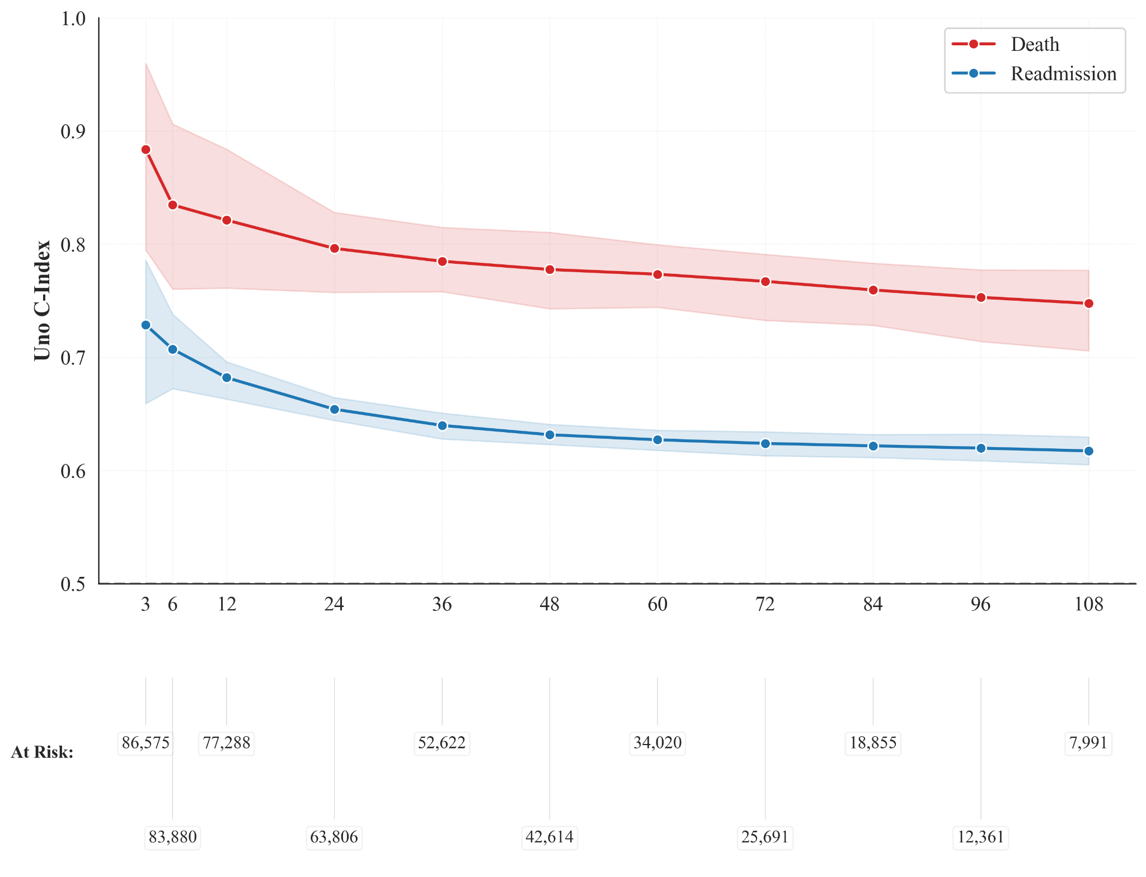
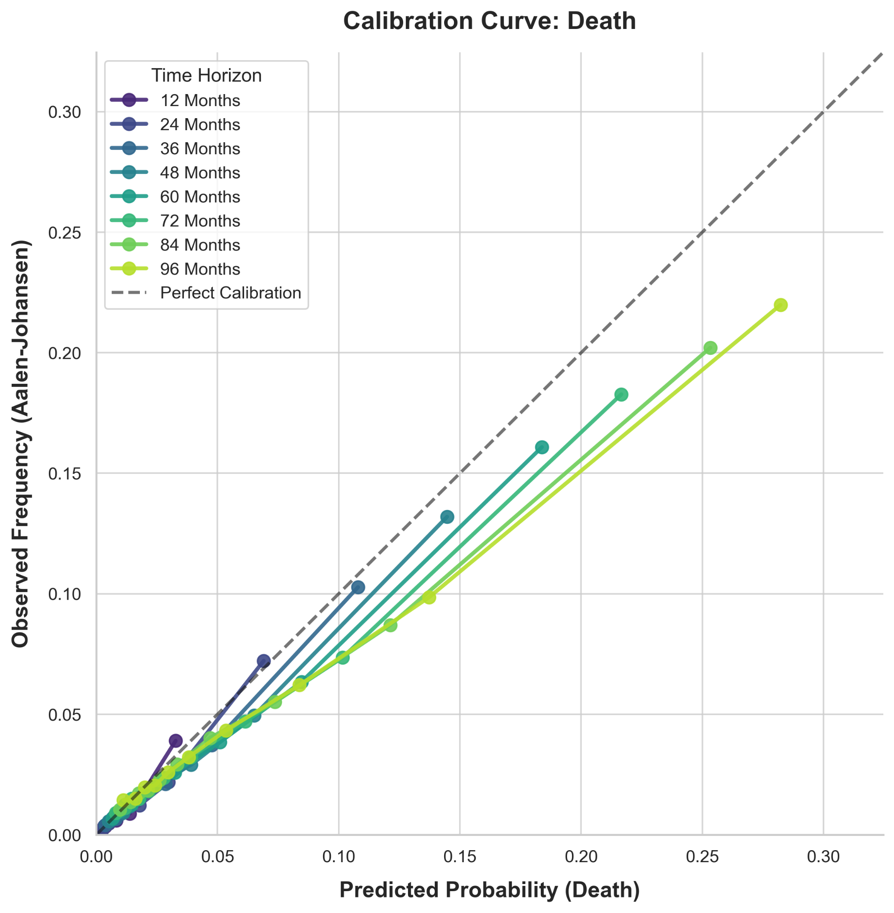
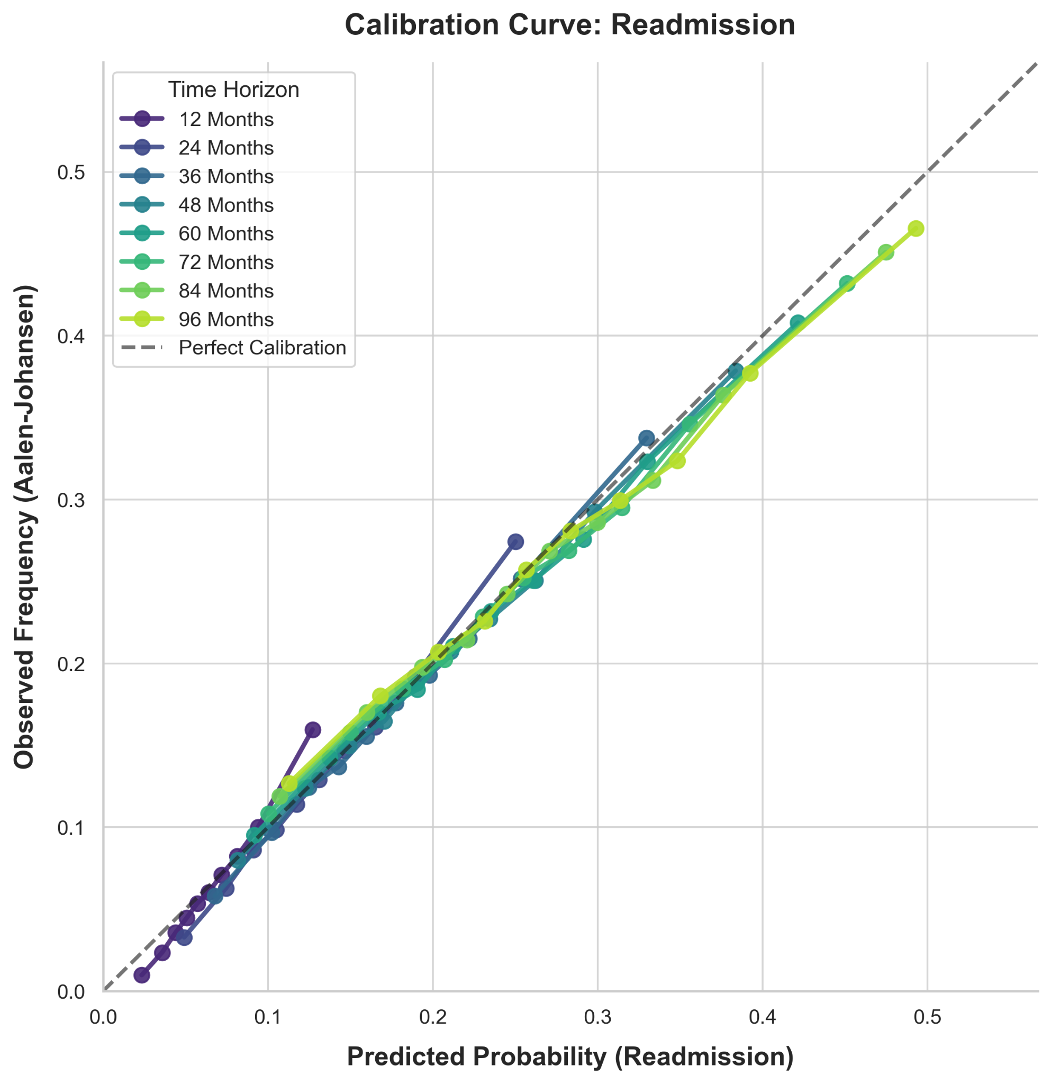
DEEP SURV(2)
MORTALIDAD
DISC= Alta a los 3 meses (0.88), decae hasta 9a= .75
CALIB= Hasta los 2 años, buena calibración temprana; 3-5a, sobreestima ligeramente; largo plazo= ligera sobreestimación (un poco mayor)
Los umbrales suben desde ~0.02–0.03 a los 3-6m (max SENS), .08-.10 a 2 años, hasta ~0.17–0.20 a los 8-9 años (equilibra precisión, -FP)
PPV= 13% 3m, 1 año=25%, 5años=26%, 9 años=36%
SENS= Detecta 12% a 3m; al año, 19%; a 5 años, 34%, a 9, 46%
1-ESP= Conservador al inicio (1%), a 5 años, 5%, 9 años= 10% mal clasificados (FP)
READMISION
DISC= A los 3m ~.73, año~.68, 2 años=.65, 9 a=.62
CALIB= Riesgo promedio predicho coincide bien con incidencia observada (AJ). BS(t) 3M= .007, al año, 0.059, 5 años, 0.16
Umbrales .09-.14 1-2 años, 0.14–0.20 5 años,
3-12m= modelo conservador (1-ESP= 2%, SENS=8%, PPV=6%); 2-4 años, marca a más personas como alto riesgo (1-ESP=44%; SENS= 63%; PPV=27%); 9 años, clasifica a todos como alto riesgo (SENS=.99; PPV=55%, 1-SPEC= 97%)
Notes:
READMISION= Se prioriza capturar todos los casos, sacrificando casi toda la especificidad. Detecto 8% de los que sí readmiten (SENS) al ppio; ya a los 9 años, 55% de los que digo alto riesgo se readmiten; 97% de las personas que NO se readmiten fueron clasificadas como alto riesgo.
While the model maintains acceptable calibration and moderate discrimination for readmission, binary classification performance at longer horizons reflects high cumulative incidence, leading to F1-optimized thresholds that prioritize sensitivity over specificity.

Slide 43
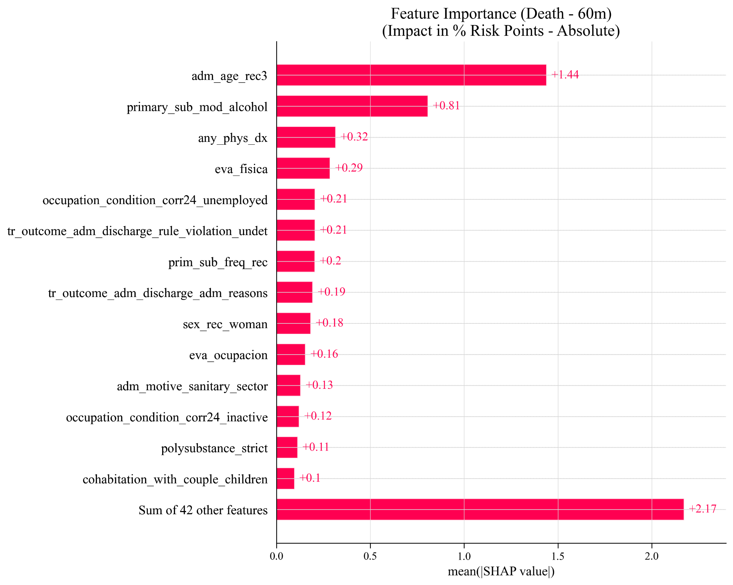
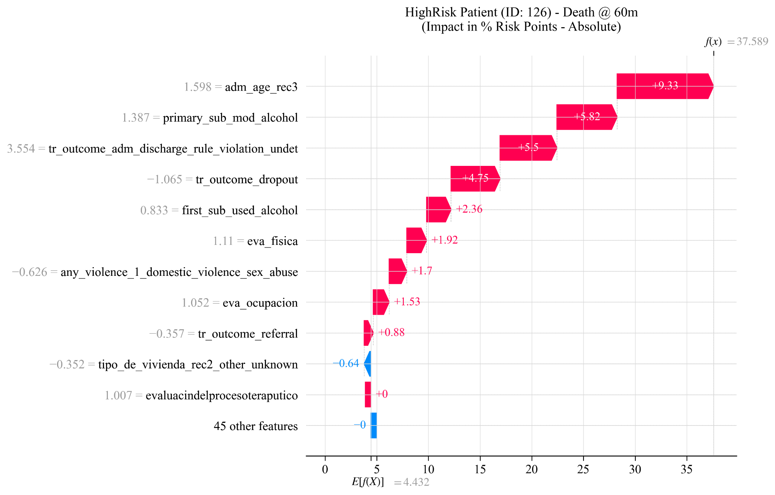

DEEP SURV(3)-SHAP
MORTALIDAD
Se eligió 5 años, pero podría considerarse otro horizonte.
Influencia:
Edad y alcohol como sus. principal
Motivo de alta (administratia; disciplinaria/violacion normas; dropout= protector vs. alta adm.)
Mujer (influencia protectora, pero no es un driver central)
Dg. psiquiátrico en estudio
Trno. mental severo; ttrno. personalidad: mixto
Trnos. del ánimo, protector leve
Inactivos y Desempleo (occ_cond), no tan influyentes como edad o comorbilidad
Marital status (single)
Vivir con hijos/pareja, protector
Pobreza multidimensional
La inestabilidad habitacional aumenta el riesgo (tenure_status_household).
Ev. al egreso, físico & Cualquier dg. físico
Variables tienden a ser más consistentes hasta el año (menor variabilidad valores SHAP)
Policonsumo, influencia mixta
Cualquier violencia: puede no ser lineal
Time Horizon (months) | Baseline Risk (Death) | Baseline Risk (Readmission)
3 | 0.14% | 0.77%
6 | 0.34% | 2.44%
12 | 0.70% | 6.88%
36 | 2.37% | 18.76%
60 | 4.18% | 24.50%
72 | 5.00% | 26.45%
84 | 5.93% | 28.09%
96 | 6.71% | 29.32%
Notes:
La edad explica la mayor parte de la variación en las predicciones individuales de mortalidad a 12 meses 👉 Son 0.05 puntos porcentuales de riesgo absoluto. dentro de la distribución de riesgos, la edad explica gran parte de la dispersión relativa (esa variable es responsable de gran parte de la variación del riesgo entre pacientes).
Local Waterfall plot= Baseline ≈ 4.43% ; Predicción final ≈ 37.59% ; rojo= influyen hacia arriba
f(x)=E[f(X)]+i∑​ϕi​
ϕi​= contribución SHAP c/var; E[f(X)]= riesgo promedio (baseline)
Descompone el riesgo predicho individual en contribuciones aditivas de cada covariable relativo al riesgo basal poblacional

Slide 44



DEEP SURV(4)-SHAP
READMISION
Se eligió 5 años, pero podría considerarse otro horizonte.
Tipo de lplan residencial (PG y M)
Etnicidad (muy consistentea 3m)
Mujer
Alcohol/Marihuana/Cocaina como sus. principal (influencia negativa)
Edad (influencia negativa, con el tiempo adquiere más consistencia)
Niv. educacional (influencia negativa)
Motivo de alta ( disciplinaria/violacion normas; dropout; derivación)
Más días de tto. (influencia neg.)
Dg. psiquiátrico
Dependencia CIE-10
Policonsumo
Desempleo
Pobreza comunal
Dirección influencia fluctuante:
Nacionalidad
Estatus marital (Sep/div./viudez(
Time Horizon (months) | Baseline Risk (Death) | Baseline Risk (Readmission)
3 | 0.14% | 0.77%
6 | 0.34% | 2.44%
12 | 0.70% | 6.88%
36 | 2.37% | 18.76%
60 | 4.18% | 24.50%
72 | 5.00% | 26.45%
84 | 5.93% | 28.09%
96 | 6.71% | 29.32%
Notes:
La edad explica la mayor parte de la variación en las predicciones individuales de mortalidad a 12 meses 👉 Son 0.05 puntos porcentuales de riesgo absoluto. dentro de la distribución de riesgos, la edad explica gran parte de la dispersión relativa (esa variable es responsable de gran parte de la variación del riesgo entre pacientes).
Local Waterfall plot= Baseline ≈ 4.43% ; Predicción final ≈ 37.59% ; rojo= influyen hacia arriba
f(x)=E[f(X)]+i∑​ϕi​
ϕi​= contribución SHAP c/var; E[f(X)]= riesgo promedio (baseline)
Descompone el riesgo predicho individual en contribuciones aditivas de cada covariable relativo al riesgo basal poblacional

Slide 45
DEEP SURV(5)-SHAP Int
MORTALIDAD
Dg. com. física x Primera sustancia, Otras (any_phys_dx × first_sub_used_other)
Sexo mujer x Resultado tto. (tr_outcome_*)
Condicion ocupacional (inactivo) x Plan PAI(M)
Cualquier diagnostico físico x Cualquier dg. enfermedad mental severa (any_phys_dx × dx_f_any_severe_mental)
Edad ingreso x PAI(M)
eva_relinterp × eva_fam × eva_consumo × evaluacion_proceso (cluster altamente correlacionado → interacción mecánica interna)
READMISION
Ethnicity x Primera sustancia, Otra
Ethnicity x Cualquier enf. mental severa
Sus. principal, Marihuana x Plan PAI (M)
Sus. prin., Marihuana x Sus. inicial, Pasta base
Referral x Sus. inicial, Otro
Sus. principal, Cocaina x Sus. inicial, Otro
Eva_ evaluaciones muy correlacionadas
Severe Mental Illness × Referral
Tipo de vivienda, desconoida x muchas (proxy de miss)
Initial, Cocaine Paste × Primary Substance: Marijuana
Admission Motive: Justice Sector × National/Foreign (OR) Tr_Outcome: Other (Posible artefacto)
AMBAS
National/Foreign × Administrative Discharge / Rule Violation (sospecha)

Slide 46




DEEP SURV(6)-SHAP Cont
MORTALIDAD
A partir de los 36 meses, mayor edad aumenta el riesgo basal
Edad= Término Lineal Continuo, pero incorporando un término deinteracción con el tiempo
Días en tratamiento= transforamción log-lineal, o RCS con 3 nodos (ej., 7, 30, 90 días); si no, categorizar la variable (<15 d, 15-30, >30d)
Porcentaje pobreza= umbral binario/categórico (para contrarrestar cero-inflados estructurales); genera mucho riesgo de muerte y (“previene” readmisión (obvio, si mueren, ojo con la estructura de riesgos y cel cause-specific cox en ese contexto)
READMISION
Pacientes mayores tienen menor riesgo de readmisión, con caídas del riesgo drásticas a los 60-96 meses (ojo con la censura)

Slide 47
Comparación modelos
Outcome | Metric (Global) | CoxNet | XGBoost (Optuna + Bootstrap optimism correction) | DeepSurv | DeepHit | Final Verdict
Death | C-Index | 0.789 | 0.751 | 0.748 | ~0.697 | CoxNet is superior. Mortality risk is primarily additive and proportional. Complex non-linear models do not provide additional discriminative value.
Readmission | C-Index | 0.609 | 0.631 | 0.616 | ~0.606 | XGBoost is superior. Treatment readmission is driven by complex, non-linear socio-clinical interactions that penalize linear parametric models.
Both | Interpretability | High | High (via SHAP) | Low (Black Box) | Low (Black Box) | Occam's Razor applies. Deep learning models fail to justify their opacity, offering no marginal performance gains over CoxNet or XGBoost.
Notes:
"While the discriminatory performance (C-index) of the DeepHit model was comparable to state-of-the-art gradient boosting methods, its primary contribution lies in its capacity to model non-linear functional forms and time-varying covariate effects without the restrictive linearity and proportional hazards assumptions required by traditional Cox regression. The discovered functional forms (e.g., the diminishing returns of treatment duration) provide actionable clinical insights that a simpler linear model would obscure."
En la literatura médica, cuando un modelo lineal/penalizado supera a los algoritmos basados en árboles o redes neuronales, el mensaje biológico es claro: los factores de riesgo para la mortalidad en esta cohorte son predominantemente aditivos y lineales. Variables como la edad avanzada, las comorbilidades físicas graves o el uso de sustancias de alto riesgo suman riesgo de manera proporcional. No hay interacciones no-lineales secretas o complejas (ej. "si tiene X edad PERO usa Y sustancia ENTONCES el riesgo se dispara") que justifiquen la arquitectura de XGBoost o DeepSurv para este desenlace en particular. Tu veredicto en la tabla es 100% acertado.
Mortalidad:
Señal fuerte
Menos ruido
Más estructural
Readmisión:
Mucha heterogeneidad
Factores no observados
Dinámicas sociales
Mortalidad ≈ 0.75 robusto. Mortalidad: 0.016 → excelente estabilidad
Readmisión ≈ 0.60–0.63 robusto. Readmisión: ~0.04–0.05 → normal en modelos complejos
Modelos complejos no superan estructuralmente a CoxNet.

Slide 48
Raphael Sonabend, Andreas Bender, Sebastian Vollmer, Avoiding C-hacking when evaluating survival distribution predictions with discrimination measures, Bioinformatics, Volume 38, Issue 17, September 2022, Pages 4178–4184, https://doi.org/10.1093/bioinformatics/btac451
Sea
S^i(t)S^ i​ (t) la curva de supervivencia predicha para el individuo ii. Para evitar C-hacking, preespecificamos una única transformación de curva a marcador escalar de riesgo:
ri(τ)=τ−∫0τS^i(t) dtr i​ (τ)=τ−∫ 0τ​ S^ i​(t)dt(donde mayor rir i​ implicamayor riesgo acumulado hasta ττ).La discriminación primariase evaluó con C-index IPCW de Uno usando el mismo marcador ri(τ)r i (τ), mismohorizonte τ
τ, y el mismo esquema de validación cruzada en todos los modelos.τ se definió a priori como el percentil 90 del tiempo de seguimiento en entrenamiento (con truncación para estabilidad IPCW).
Como análisis secundarios preespecificados, reportamos desempeño a 12, 36 y 60 meses con AUC dependiente del tiempo y Brier score. No se seleccionaron métricas post hoc según resultados.
Suplemento (transparencia anti C-hacking)
Transformación primaria fija:
ri(τ)=τ−∫0τS^i(t) dtr i​ (τ)=τ−∫ 0τ​ S^ i​(t)dt.Métrica primaria fija: C-index IPCW (Uno) con el mismo
ri(τ)r i​ (τ).Comparabilidad entre modelos: toda comparación usa la misma transformación y la misma métrica.
Horizontes secundarios fijos: 12, 36, 60 meses (AUC/Brier).
Validación: CV estratificada;
τ y cualquier truncación definidos sin usar datos de test.
Reporte completo: se informan todos los resultados preespecificados (primarios y secundarios), sin descarte selectivo.
El C-Index se inventó para comparar riesgos relativos (números simples). Pero, ¿qué pasa si tu modelo escupe una curva completa? Tienes que transformar esa curva en un número simple para poder calcular el C-Index. El paper denuncia que la literatura casi nunca explica cómo se hace esta transformación, lo que lleva al C-hacking (manipular los resultados, a lo "p-hacking").
Los autores identifican tres tipos de C-hacking:
Tipo I: Probar muchos C-indices distintos y publicar solo el que da el número más alto.
Tipo II: Mezclar peras con manzanas. Decir que un modelo es mejor que otro comparando el C-index "X" de uno contra el C-index "Y" del otro.
Tipo III (El más común e involuntario): Comparar un modelo que predice curvas con uno que predice números simples, sin transparentar la fórmula matemática que usaste para convertir la curva en un número. Dependiendo de cómo aplastes esa curva (ej. tomando la media, mirando un tiempo específico t, o calculando la "mortalidad esperada"), el C-index cambia drásticamente.
Recomienda usar el C‑index solo como medida descriptiva de discriminación, no para comparar modelos ni tomar decisiones. Prefiere métricas como pseudo‑R2, AIC y distribuciones de riesgos predichos. (https://discourse.datamethods.org/t/is-harrells-concordance-index-not-proper-when-using-predicted-times/28290?utm_source=copilot.com)
To me the bottom line is the AUC should be used to describe discrimination of one model, not to compare 2 models. For comparison we need to use the most powerful measure: deviance and those things derived from deviance: generalized
R 2 and AIC. – Frank Harrell Commented

Slide 49
Net benefit
Decision curve analysis was performed within the internally validated sample. Although optimism was minimized using bootstrap procedures, external validation is required to confirm clinical utility
“optimism-corrected net benefit”
The clinical value of risk prediction varies by time horizon

